Slide 1
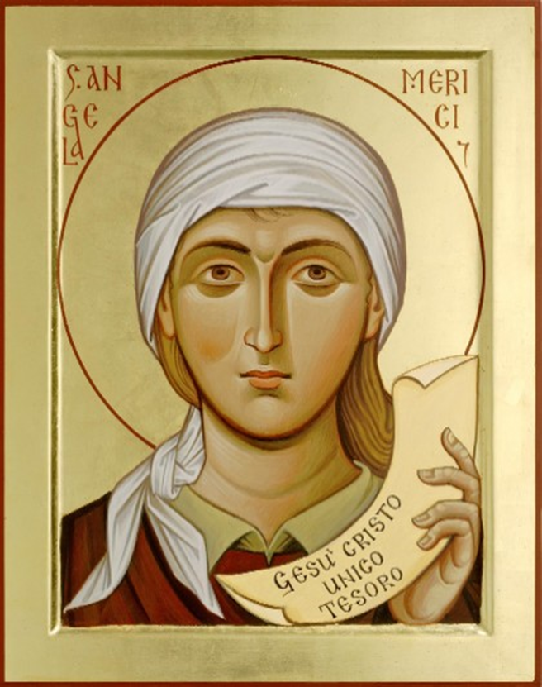
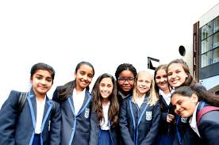
∼ . ∼ . ∼ United in Harmony ∼ . ∼ . ∼
“See then how important is this
UNION and CONCORD.
So
LONG for it
PURSUE it
EMBRACE it
HOLD on to it with all your STRENGTH”
St. Angela
May they all be ONE Father. May they be ONE in us, as you are in me and I am in you.
Jn 17.21
Angela observed how the gift of speech can be used to either strengthen or weaken relationships. “COMFORT” and “ENCOURAGE” are among her favourite words. She advises asking “pardon….to preserve love” and to cut out “Swearing……..answering haughtily, grumbling, repeating malicious gossip”. And finally “let all our words always be for the instruction and building up of those who have dealing with us”.
To be UNITED in HARMONY is to be what we already are: interconnected with the divine, all humanity and indeed with all CREATION
Our challenge is to grow in awareness of this fundamental communion, strengthen it and ACT out of it in the TRUTH to who we are in our relationships with others.
St Angela Merici
A dominant theme in the teaching of Angela is the importance of GOOD RELATIONSHIPS
Her inspiration was the community of total giving and receiving which is the
HOLY TRINITY
Harmony flows from such unpossessive relationships that only desire the GOOD of the OTHER and are open to receive what the other has to give.
“My last word to you, by which I implore you even with my blood, is that you
LIVE in HARMONY, UNITED – Insieme – TOGETHER
ALL of
ONE heart and ONE will”
St. Angela, Last Counsel
Ursuline Pupils
Questions for Reflection
Are there opportunities for staff and pupils to celebrate together ‘Insieme’?
Do pupils learn to honour and value their heritage as an Ursuline school?
Does your school seek ways of linking staff and pupils with Ursuline schools worldwide?
Ursuline Schools help their pupils to use their gifts of speech and time to nourish enriching relationships that bond a community
TOGETHER
‘Insieme’
I am the vine; you are the branches
Jn 15.5
The Ursuline Student Profile in the Merician Tradition ∼ . ∼ .
This Photo by Unknown Author is licensed under CC BY-NC-ND

