Slide 1
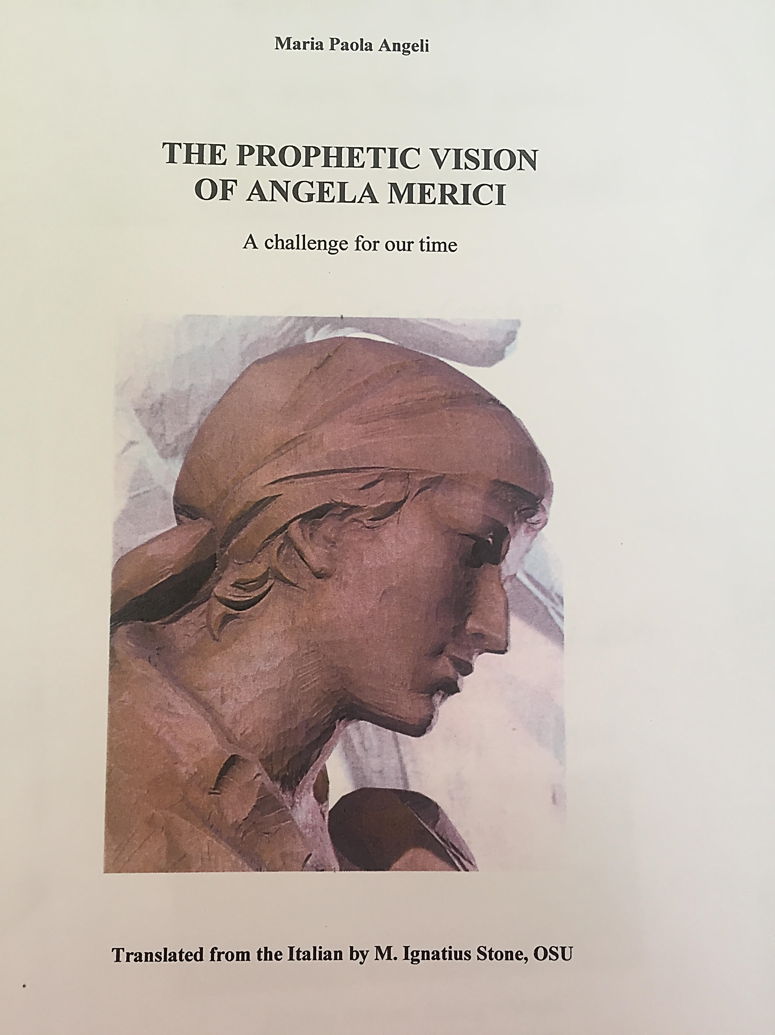
All the quotations in this presentation are taken from this book

Slide 2
United in Harmony
“I tell you, living all together this united in heart, you will be like a mighty fortress or tower, impregnable against all adversities.” p 23

Slide 3
United in Harmony 2
“And there will be no other sign that you are in the grace of the Lord than that you love one another and are united
together.” p 24

