Slide 1
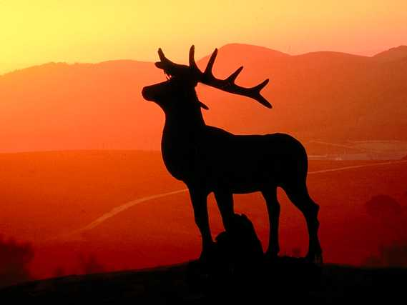
The
Deer's
Cry
(From the “Breastplate of St. Patrick”)
by Kuno Meyer
Music by Sean Davey / Sung by Rita Connolly

Slide 2
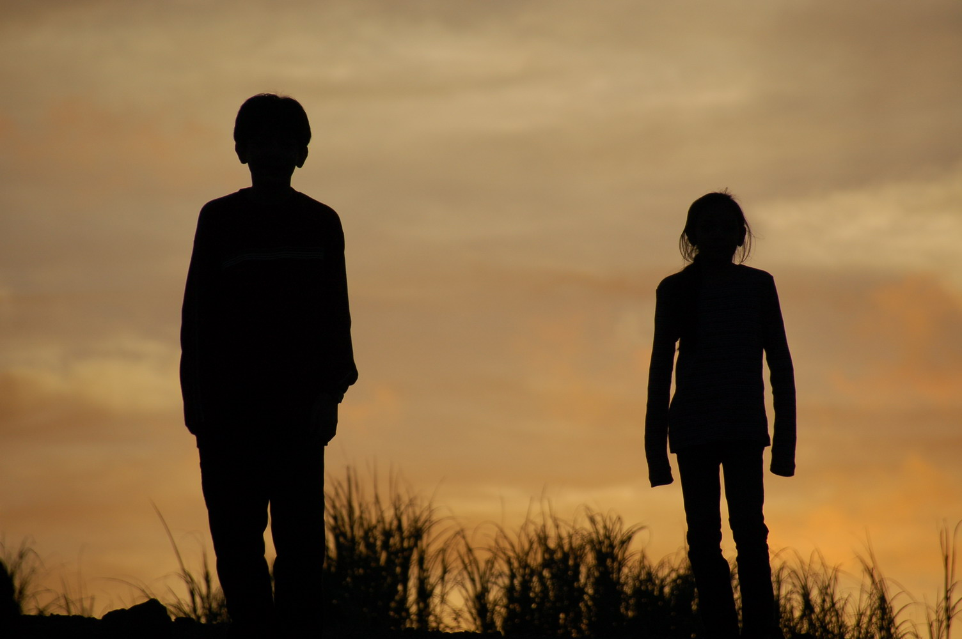
I arise to-day
through the strength of heaven:

Slide 3
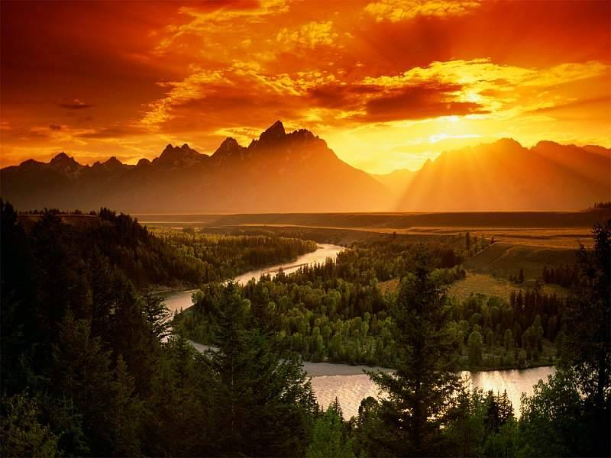
L i g h t o f s u n

Slide 4
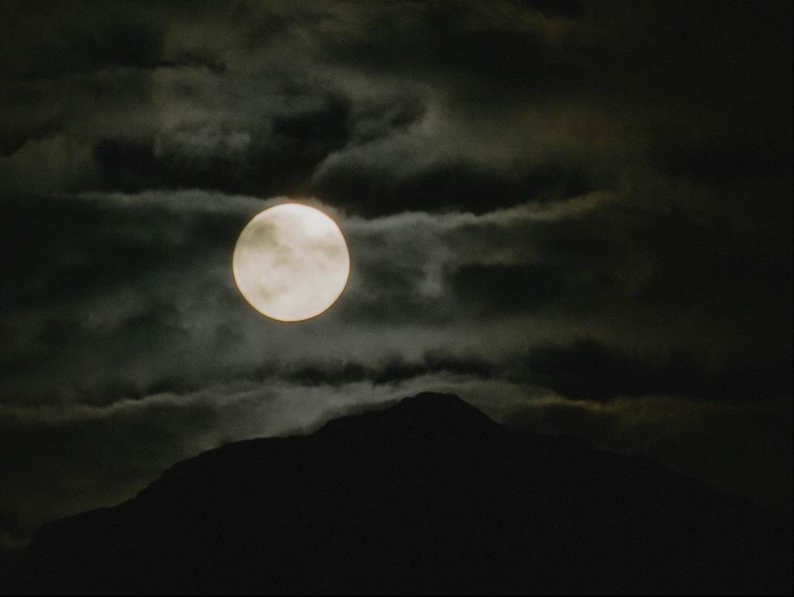
R a d i a n c e o f m o o n

Slide 5
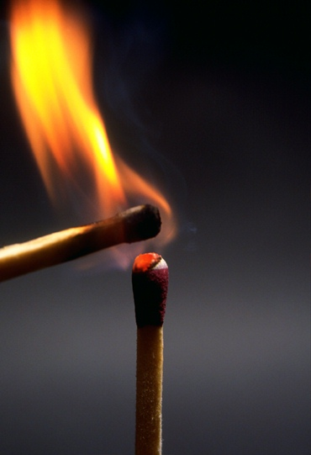
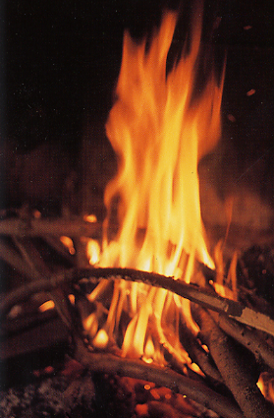
S p l e n d o u r
o f
F i r e

Slide 6
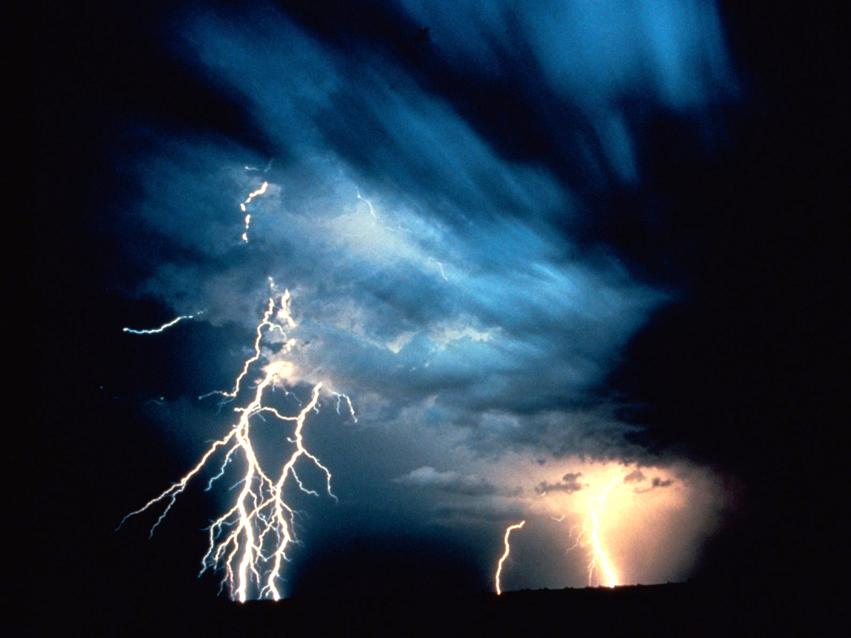
Speed of lightning

Slide 7
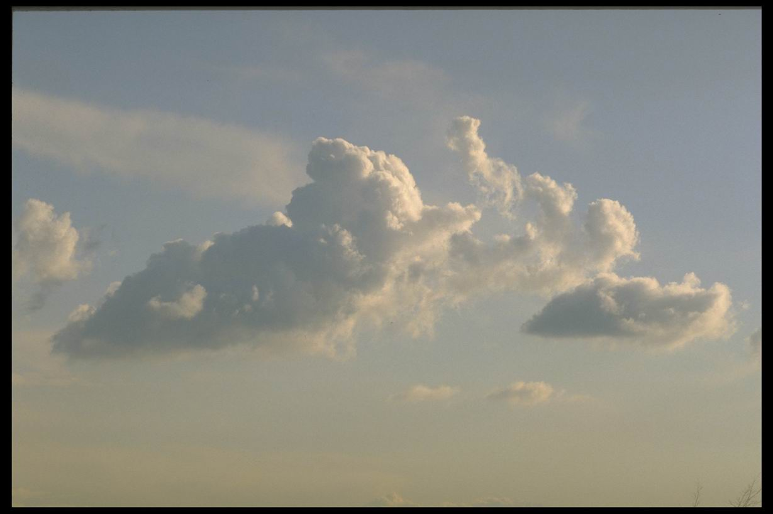
Swiftness of wind

Slide 8
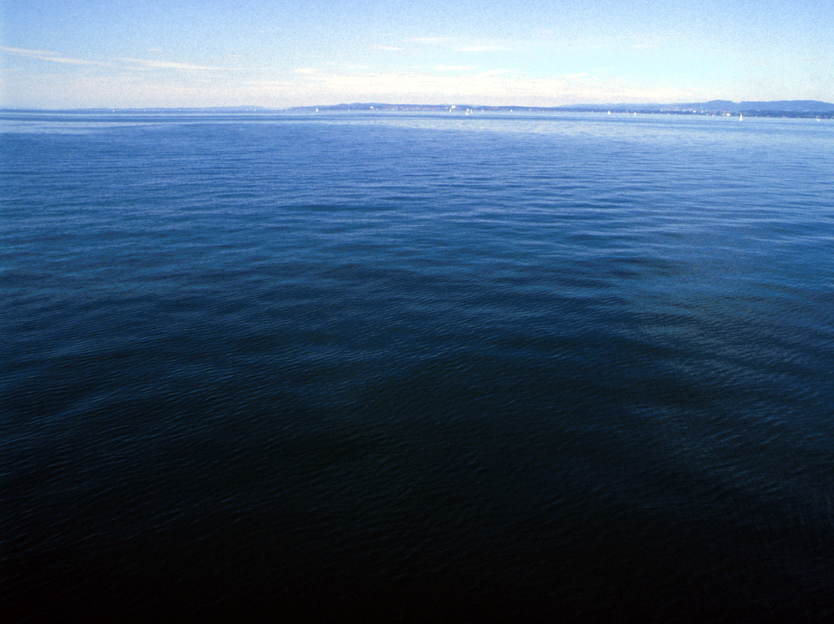
D e p t h o f t h e s e a

Slide 9
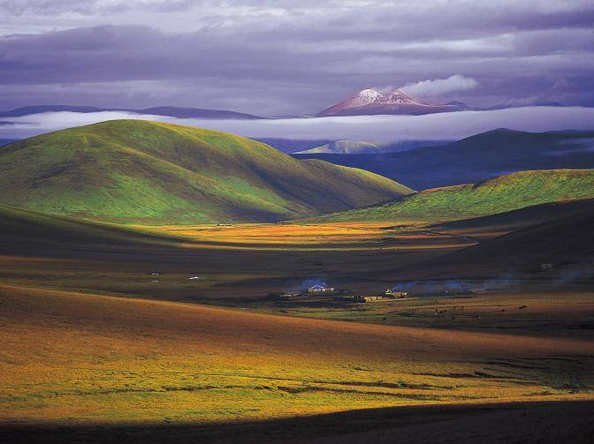
S t a b i l i t y o f e a r t h

Slide 10
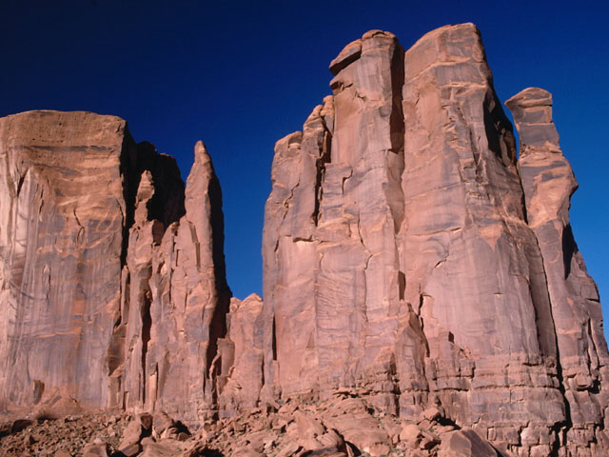
Firmness of rock.

Slide 11
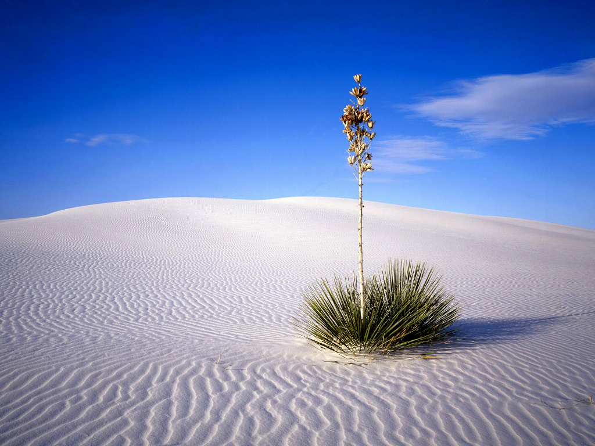
I arise to-day
through God’s strength to pilot me:
God’s eye to look before me
God’s wisdom to guide me
God’s way to lie before me
God’s shield to protect me

Slide 12
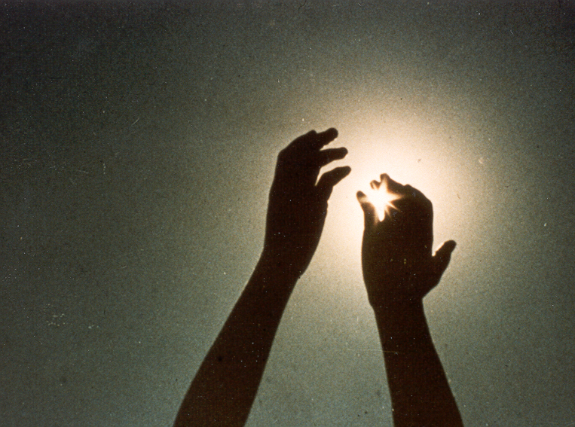
From all who shall wish me ill
Afar and anear, alone and in a multitude
Against every cruel merciless power
that may oppose my body and soul.

Slide 13
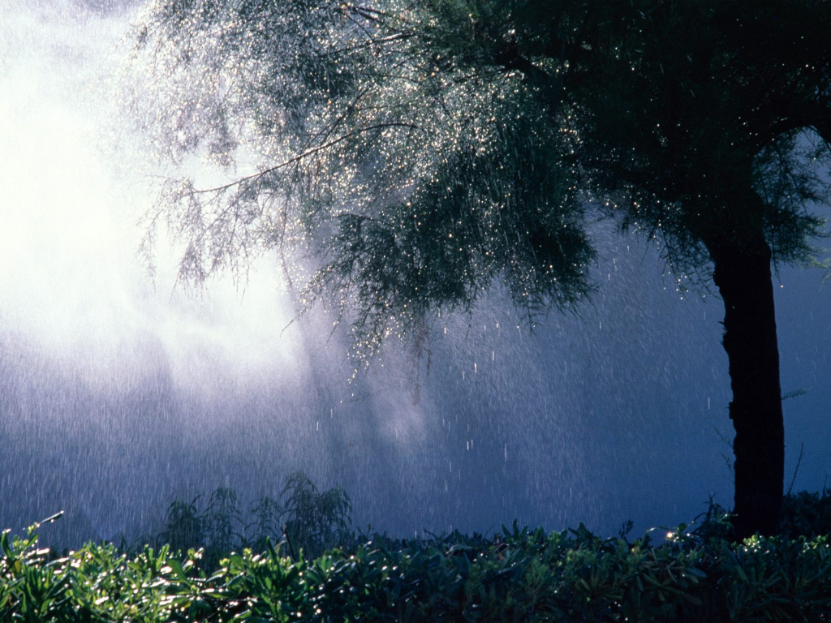
Christ with me, Christ before me
Christ behind me, Christ in me
Christ beneath me, Christ above me
Christ on my right, Christ on my left

Slide 14
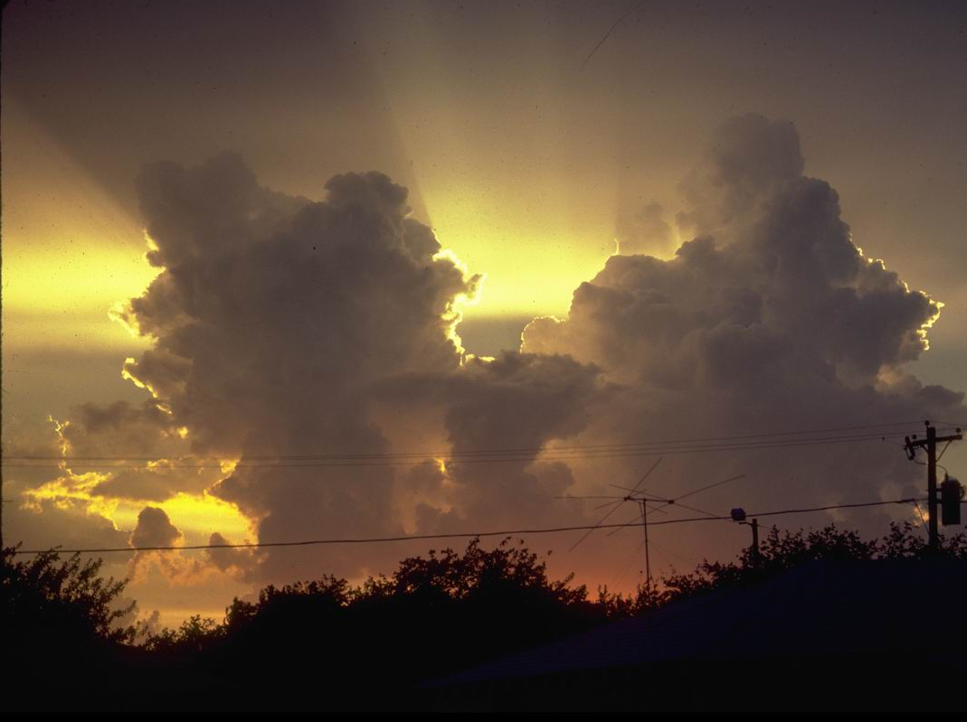
Christ when I lie down,
Christ when I sit down,
Christ when I arise,
Christ to shield me

Slide 15
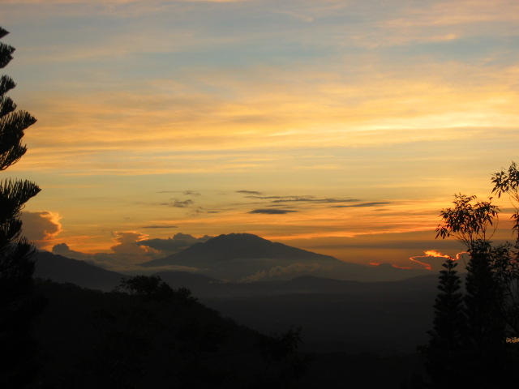
Christ in the heart of every one
who thinks of me
Christ in the mouth of every one
who speaks of me.

Slide 16
I a r i s e t o – d a y …

Slide 17
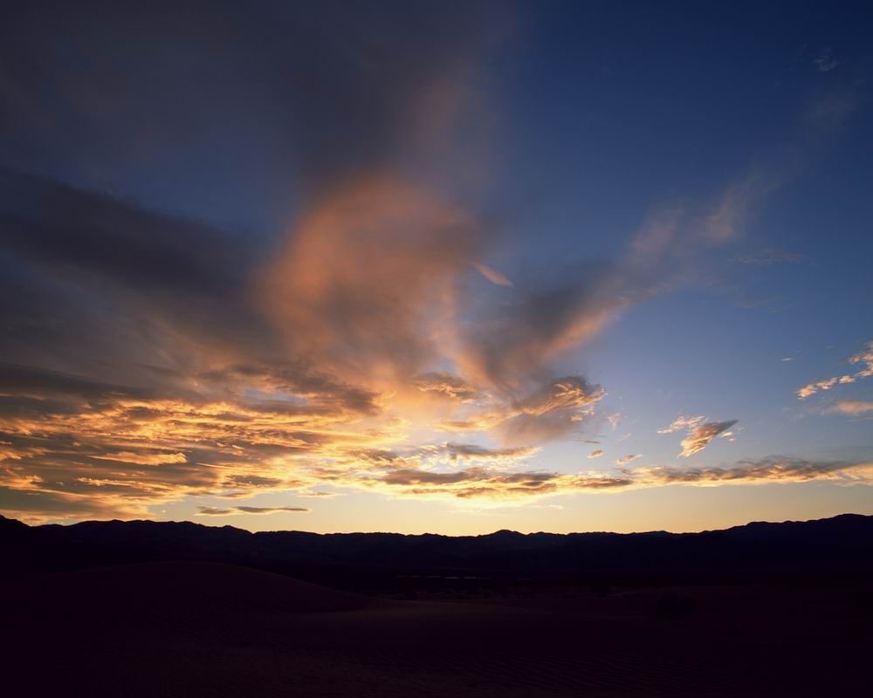
Through a mighty strength,
the invocation of the Trinity.
Through belief in the Threeness,
Through confession of the Oneness
of the Creator of Creation. Amen.

Slide 18
The
Deer's
Cry
(From the “Breastplate of St. Patrick”)
by Kuno Meyer
Music by Sean Davey / Sung by Rita Connolly
PowerPoint by Leonor de la Santa, fmm (2014)
Photos from private collection and Internet sources

