Slide 1
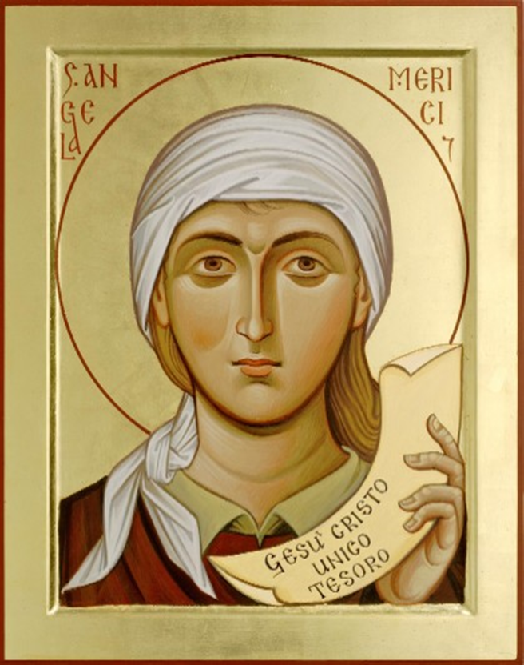
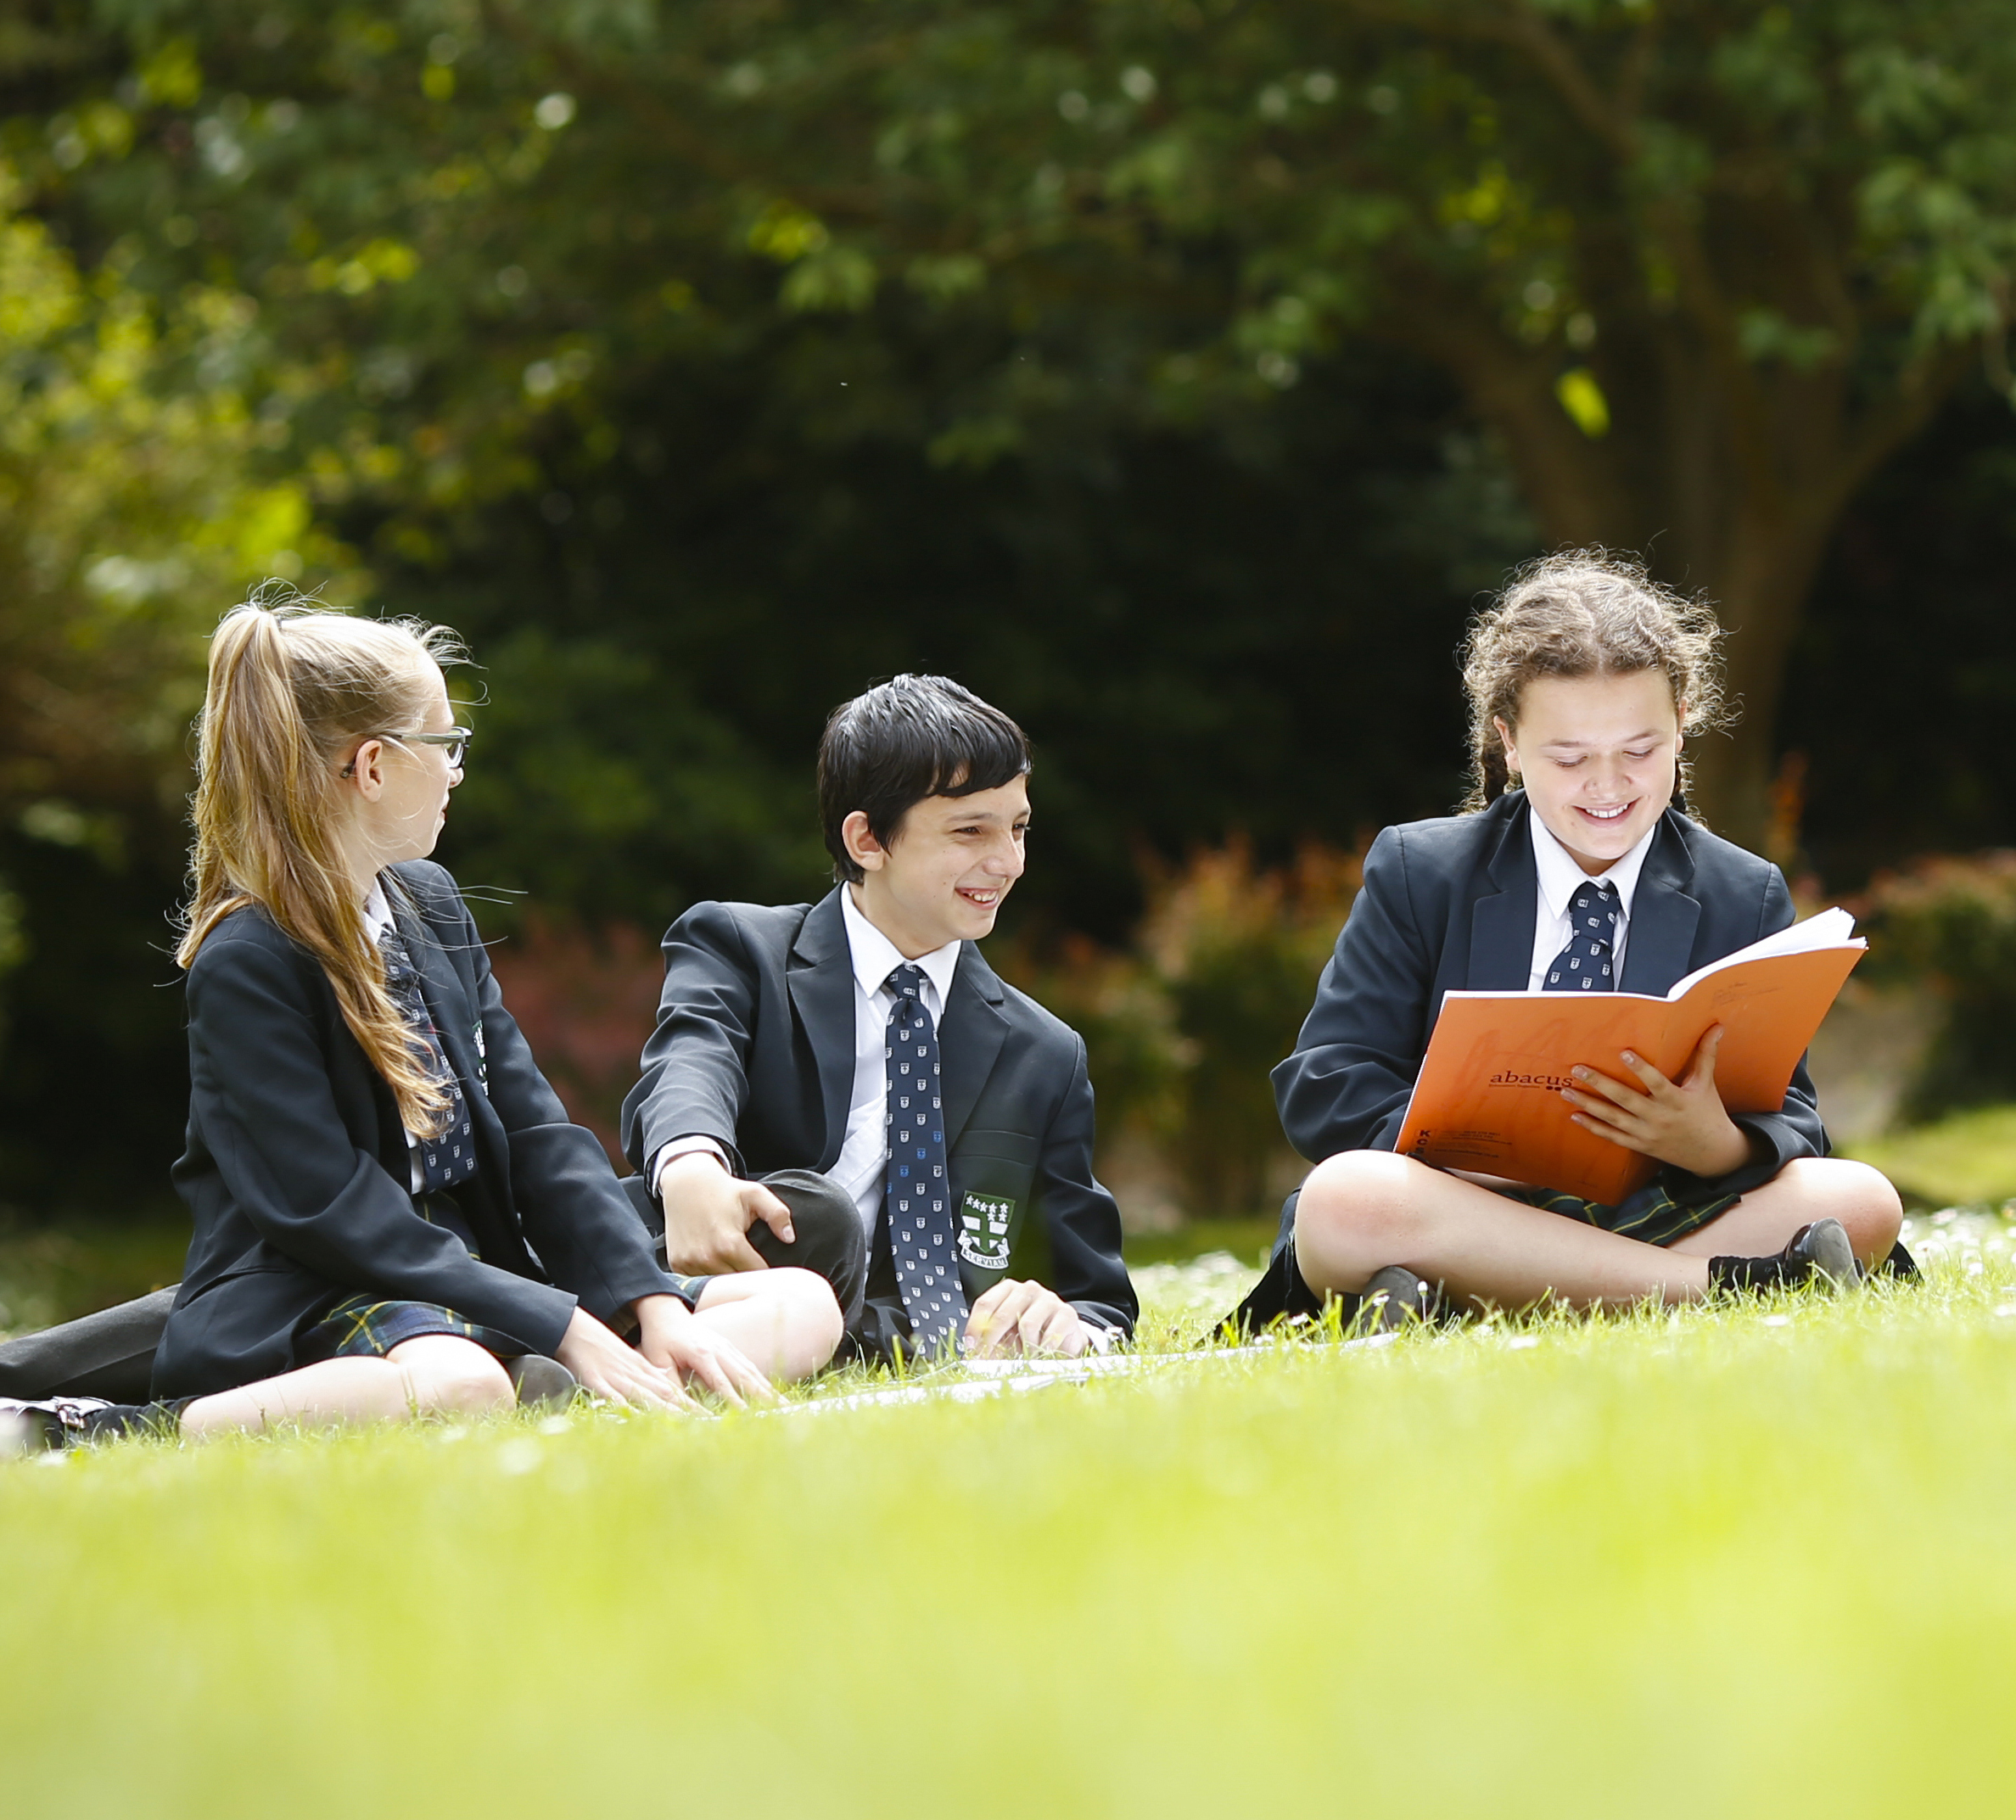
∼ . ∼ . ∼ Loving and Compassionate ∼ . ∼ . ∼
Angela’s writings overflow with words like: ’LOVE, LOVING, GENTLENESS, CHARITY, COMFORT, ENCOURAGE, CONSOLE. These words convey the vision Angela has for us: a community in which each one is valued in his or her uniqueness and everyone puts the other first. Angela expects a high standard in our loving and compassion but it must be done with discernment.
“Love one another, as I have loved you. A man can have no greater love than to lay down his life for his friends”
Jn.15.13
“…..the God of all consolation, …..comforts us in all our sorrows, so that we can offer others, in their sorrows, the consolation we have received from God ourselves
2 Cor 1.3-4
“
“I feel sorry for all these people; they have been with me for three days now and have nothing to eat”
Mark 8.2
St Angela Merici
“..let..their words be wise and reserved..
compassionate and leading to concord and charity”
Angela 5th Counsel
Questions for Reflection
How are students led to respect each person’s dignity and grow in awareness of differing needs?
Are students taught the need for discernment when seeking to help others?
What opportunities are there for students to learn about social needs beyond the classroom and seek to make their own contribution in meeting them?
“Together encourage one another”
Angela 8th Counsel
“…let all their behaviour, their actions and their words be with charity and let them bear everything with patience”
Angela 5th Counsel
Ursuline Schools help their students grow in love and compassion by the way they personally are treated and by opening their eyes and hearts to those who suffer poverty, injustice or violence.
“Love…..equally; and do not prefer one more than another”
Angela 8th Counsel
. ∼ . ∼ The Ursuline Student Profile in the Merician Tradition ∼ . ∼ .
This Photo by Unknown Author is licensed under CC BY-NC-ND

