Slide 1
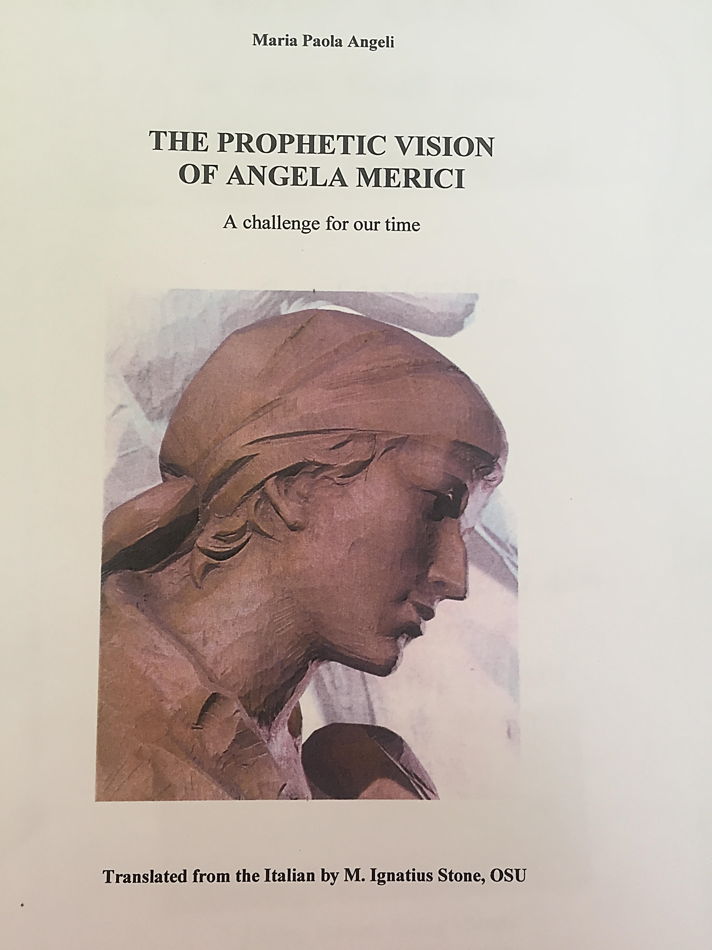
All the quotations in this presentation are taken from this book

Slide 2
Loving and compassionate 1
Gifted with tremendous empathy in consoling human grief, Angela welcomed, listened, made suggestions, settled quarrels and found answers to some very delicate questions. 9
“She was like a sun that gave light to all others… afire and furnace of love which enflamed them. Her words were ardent, powerful, gentle and pronounced with such a strength of grace that each one felt compelled to say: God is here.” Cozzano- from Zela

Slide 3
Loving and compassionate 2
“And so we are called to so glorious a life as to be spouses to the Son of God and to become queens of heaven” – giving an alternative, spiritual and meaningful life to women who had no husband, no dowry no monastery 29
Although you are perceived as being weak, living together you will become strong 29

Slide 4
Loving & compassionate 3
People complained about the company being made up of lowly, uneducated women but as Cozzano remarked: “True nobility. True distinction lies in the heart, in the prudence that knows how to choose what should be loved by all else. For when this is so, so also will be the heart and the soul of the one who has loved it. p30
Even though she lived the life of the ascetic, fasting and doing penance, it was not compulsory and indeed Angela was aware that it could become destructive p31

Slide 5
Loving & compassionate 4
Authority should be exercised in a maternal way and seen as a service and loving act in which dominion plays no role p35
“to comfort them and help them if they should happen to be in some situation or disagreement or other trouble, of body as much as of mind” Chat 10 Rule 4,8,9 p35
Love was Angela’s constant companion. p37
The prophecy of love in the experience of Angela Merici stands out in the way she made herself the promoter of new life in others, in generating it, cultivating it and making it grow. p37

Slide 6
Loving and Compassionate 5
Be gentle and compassionate towards your dear daughters…..for you will achieve more with kindness and gentleness than with harshness and sharp rebukes, which should be reserved only for cases of necessity, and eve then, at the right place and time, and according to persons” 2nd counsel 1-5 p 41
“it will be impossible for you not to cherish them day and night and to have them all engraved on your heart, one by one, for this is how real love acts and works” Pro Counsel 11, 42

