Slide 1
Ursuline
Education
Community
Ursuline Student Profile
Grateful & Generous, January – February 2020

Slide 2
Grateful & generous Jan-Feb 2020, 6 weeks
Angela was always grateful, sure in the knowledge that every day, every person, every event was a gift. Cultivating this sense of gratitude can help us enormously in our lives, both in times of great joy and times of great challenge. Angela’s generous spirit and heart informed her life and is outlined clearly in the guidance she left us: “Be united to one another, with bonds of charity, esteeming each other, helping each other, bearing with each other in Jesus Christ.”

Slide 3
Grateful & generous
Students in an Ursuline school are
growing to be individuals who are…
Ursuline schools help their students grow…
grateful for their own gifts, for the gift of other people, and for the blessings of each day; and generous with their gifts, becoming women and men for others.
By encouraging them to know and be grateful for all their gifts, developing them to the full so that they can be generous in their service of others.

Slide 4
https://www.ted.com/talks/louie_schwartzberg_nature_beauty_gratitude?referrer=playlist-talks_to_watch_with_the_entire#t-342894
Nature, Beauty. Gratitude.
With Brother David a few mins in

Slide 5
BROTHER FRANZ STEINDL-RAST OSB 1926-
He spent all of his teen years under the Nazi occupation, was drafted into the army, but never went to the front lines. He eventually escaped and was hidden by his mother until the occupation ended.
In 1952 he followed his family who had emigrated to the United States. In 1953 he joined a newly founded Benedictine community in Elmira, NY, Mount Saviour Monastery, where he became “Brother David.”
Brother David was sent by his abbot to participate in Buddhist-Christian dialogue, for which he received Vatican approval.
He has received many awards for his work in building bridges between religious traditions.
At present, Brother David serves a worldwide Network for Grateful Living, through Gratefulness.org, an interactive website with several thousand participants daily from more than 240 countries and territories.

Slide 6
https://www.youtube.com/watch?v=3Zl9puhwiyw
Same talk over this time from Brother David
Only
Shorter=- 5 mins

Slide 7
Books by Brother David- all on
Amazon

Slide 8
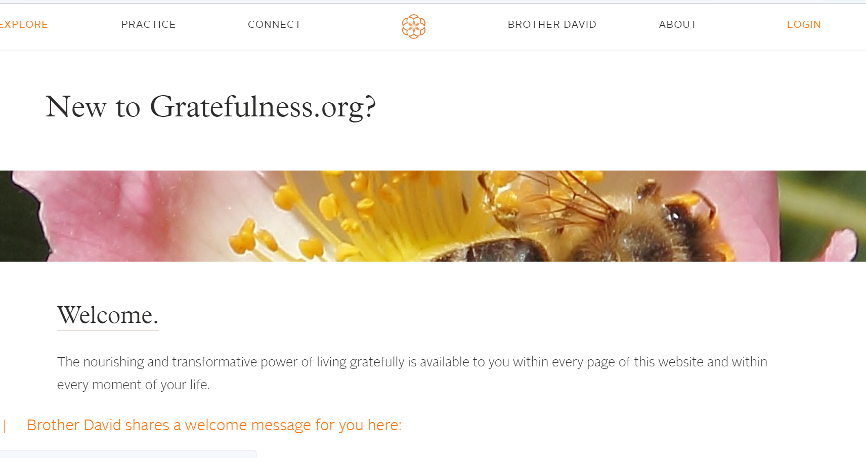

Slide 9
https://gratefulness.org/explore/new-to-gratefulness/
Brother David’s introduction to
www.gratefulness.org

Slide 10
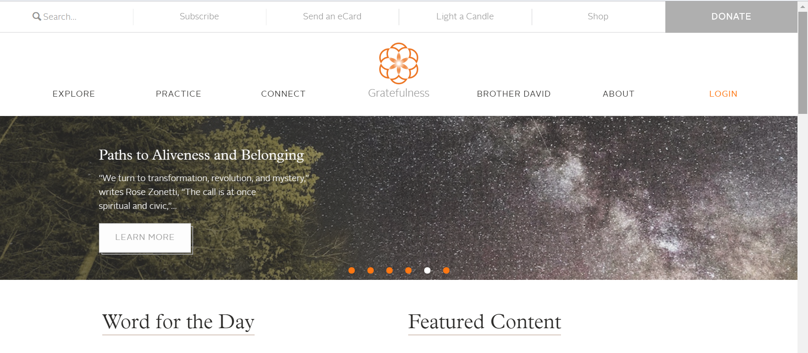

Slide 11
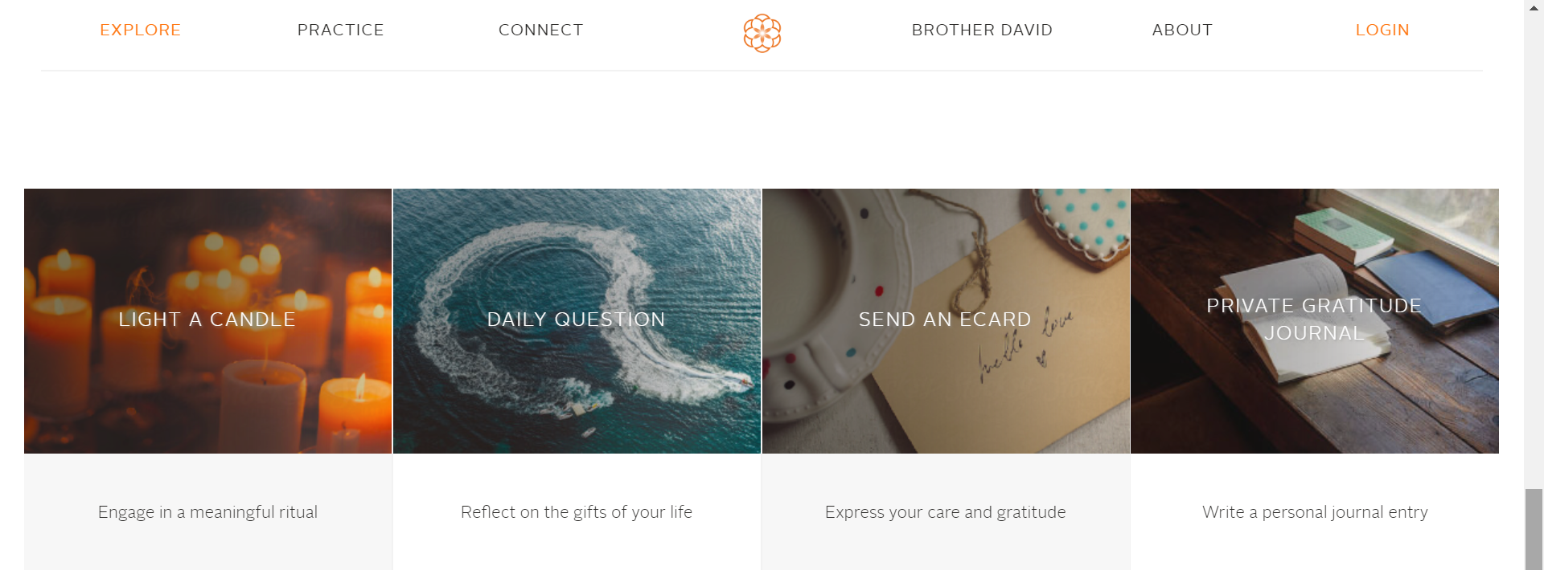

Slide 12
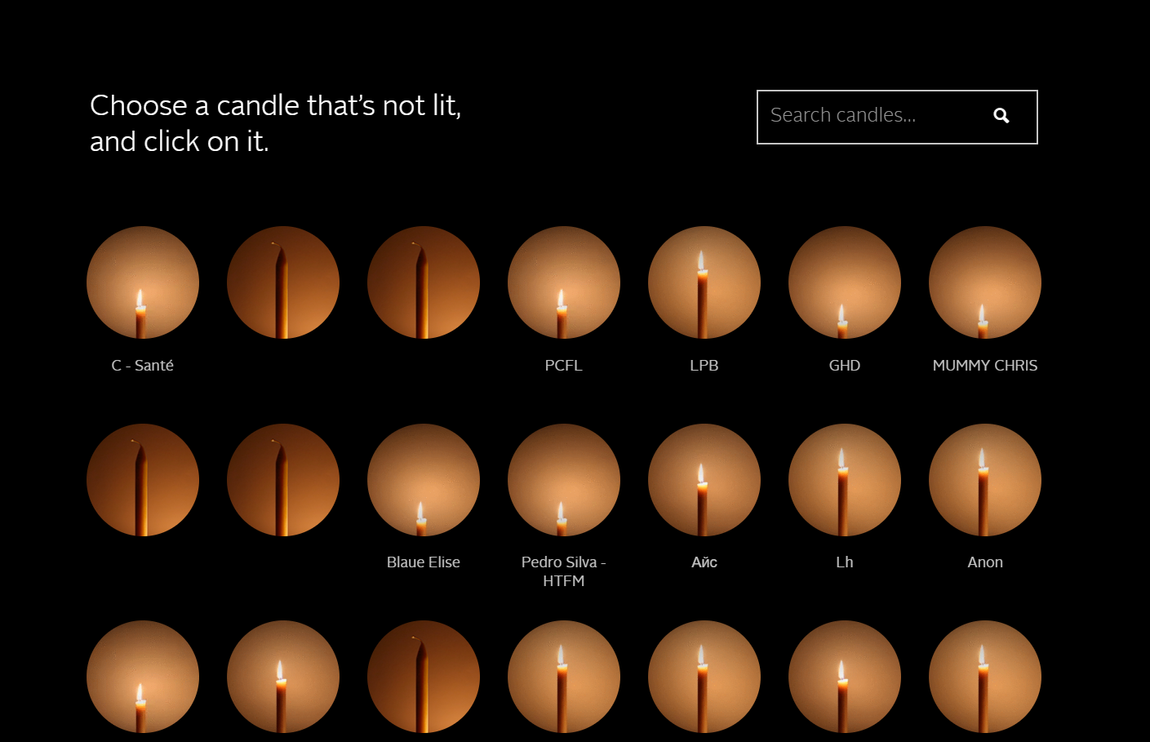

Slide 13
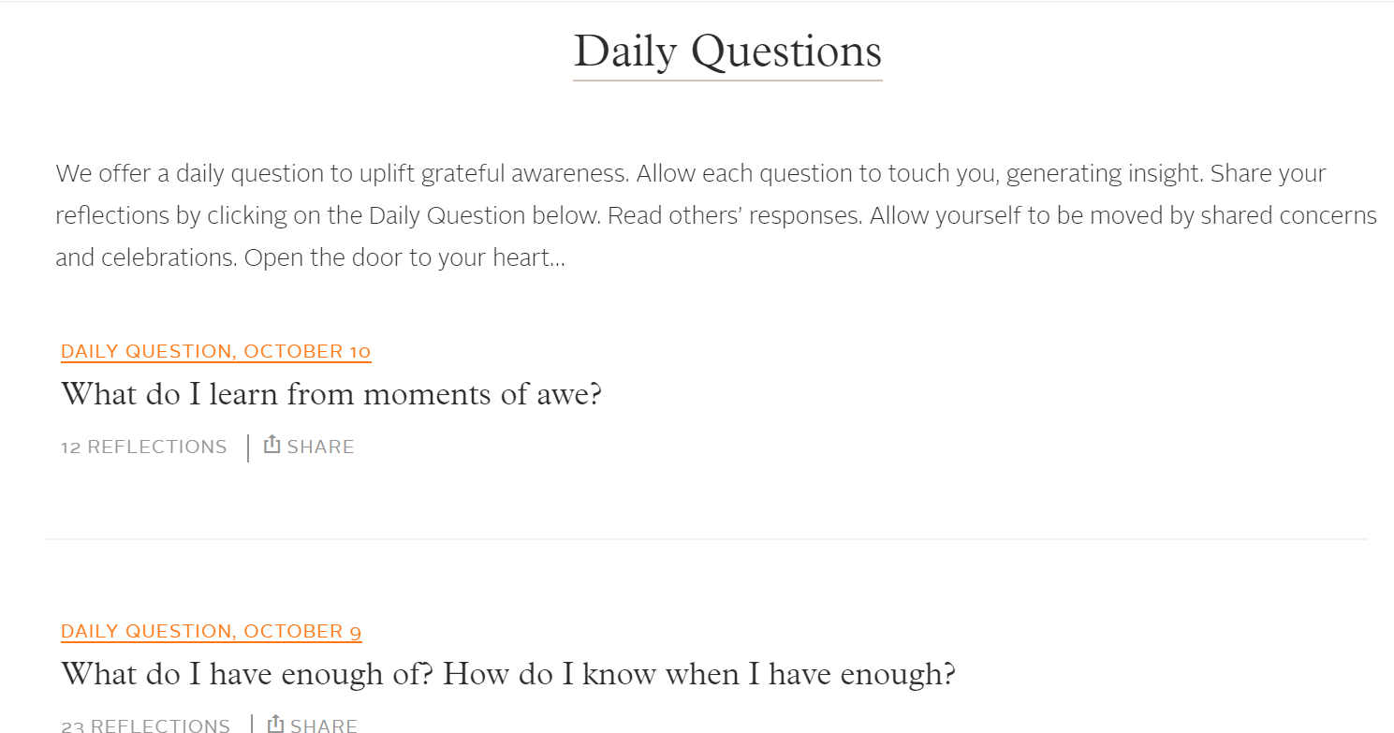

Slide 14
Can you teach character?
https://www.youtube.com/watch?v=pYAIqt2V0eY
University of Birmingham 2015: introduction
https://www.youtube.com/watch?v=NvOI6riltzw
University of Birmingham Full video
https://www.youtube.com/watch?v=w6I6zNiH1-w
Can you teach character- 15 mins, kids talking 2017
https://www.youtube.com/watch?v=r9QkaOaUST8
Can you teach character – short version, 5 mns 2017
https://www.youtube.com/watch?v=dsbAovAsnoY
Can schools teach character – US – 2017
https://www.youtube.com/watch?v=sxHGSTV3LF0
TEDx talk – Teaching Character-US - the other half of the story, 12 mins 2016
https://www.youtube.com/watch?v=Qb1-F_Ud54c
TEDx talk- The importance of character education, Putney High School, 2016
Very useful for discussion and debate with staff and older students
University of Birmingham’ Jubilee Centre – lots of good resources there
The clip we watched at the meeting

Slide 15
https://www.youtube.com/watch?v=ovj5dzMxzmc
The man in the queue
https://www.youtube.com/watch?v=1DUYlHZsZfc
Do your parents embarrass you?
https://www.youtube.com/watch?v=2eTbs6cZ61I
The most generous boy in the world
https://www.youtube.com/watch?v=y9N8OXkN0Rk
Eating Twinkies with God
Generosity, “feel good”
clips- suitable for
all age groups
There are 100s on
youtube

Slide 16
“Girl Up”:
V powerful talk for older girls on raising self esteem, being truly grateful for who you are
https://www.youtube.com/watch?v=t6dnl9srW5k
Girl Up: The Secrets to an Extraordinary Life
TEDx talk- 15 mins, over 1 million views

Slide 17
Random Acts of Kindness
Day 2020 is observed on Monday, February 17, 2020
Ash Wednesday
Feb 26th – you might want to have a RAK campaign in Lent

Slide 18
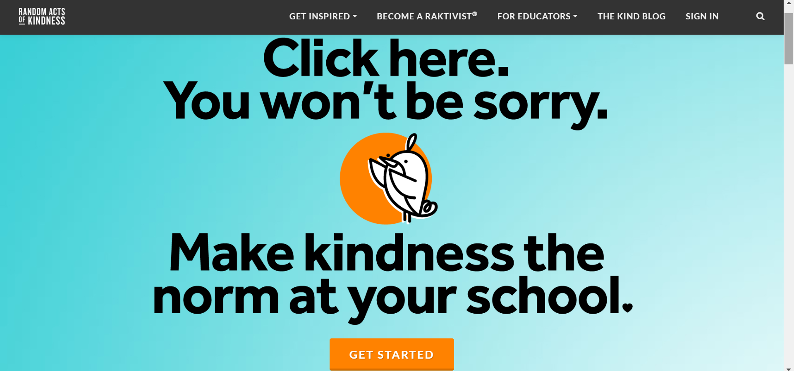
www.randomactsofkindness.org
Lesson plans

