Slide 1
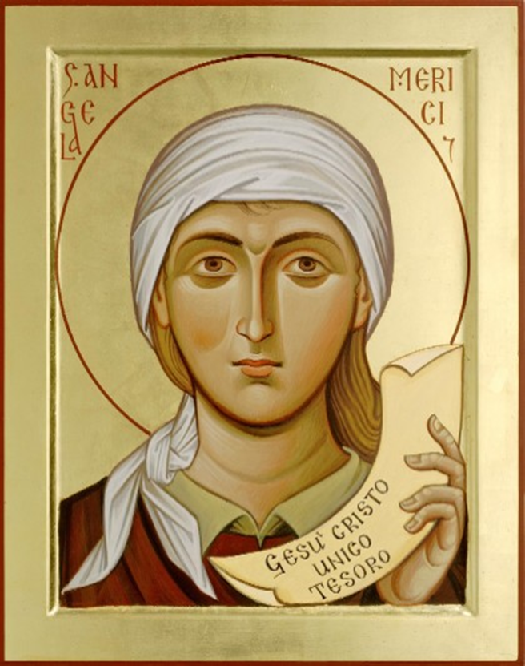
∼ . ∼ . ∼ Grateful and Generous ∼ . ∼ . ∼
Ursuline students are growing to be grateful for their own gifts, for the gift of others, and for the blessings of each day; and generous with their gifts, becoming men and women for others.
‘God has created me to do Him some definite service. He has committed some work to me which He has not committed to another. I HAVE MY MISSION….. I am a link in a chain, a bond of connection between persons…….
I SHALL DO GOOD’
St. John H Newman
“I tell you truly this poor widow has put in more than any of them……from the little she had she had put in all she had to live on”
Luke 21.3-4
GRATITUDE is a quality St Angela emphasises
She writes: “Oh, how much you have to THANK Him for…….”
St. Angela
“Give, and there will be gifts for you in full measure……..because the amount you measure out is the amount you will be given back”
Luke 6.38
St Angela Merici
As all is GIFT we are not entitled to anything: courtesies, privileges, rewards. St. Angela says: “regard yourselves as ministers and servants……….learn from Our Lord who, while he was in this world, was a servant” .
“If the only prayer you said was ‘Thank you’, that would be enough
Meister Eckhart ps. 1260-1338
Questions for Reflection
How are students encouraged to identify and celebrate their own gifts and the gifts of others?
Is ‘thank you’ something that is often heard around your school? Are there lots of different kinds of ‘thank you’?
Does your school set out to create opportunities for students to be generous – not just with their money but their time, talents and energy?
“Finding himself cured, one of them turned back praising God……and threw himself at the feet of Jesus and THANKED Him
Luke 17.15-16
“I THANK you, Lord, with all my heart, you have heard the words of my mouth…….I THANK you for your faithfulness and love”
Ps. 137, v1-2
Ursuline Schools help their pupils to grow by encouraging them to know and be GRATEFUL for all their gifts, developing them to the full so that they can be GENEROUS in the services of others
1st Counsel GENEROSITY
Angela recognised that personal call and gifts brought responsibility to develop and share. She especially calls us to encourage and support others in following their unique call: giving of our presence and time to others.
The Ursuline Student Profile in the Merician Tradition ∼ . ∼ .
This Photo by Unknown Author is licensed under CC BY-NC-ND

