Slide 1
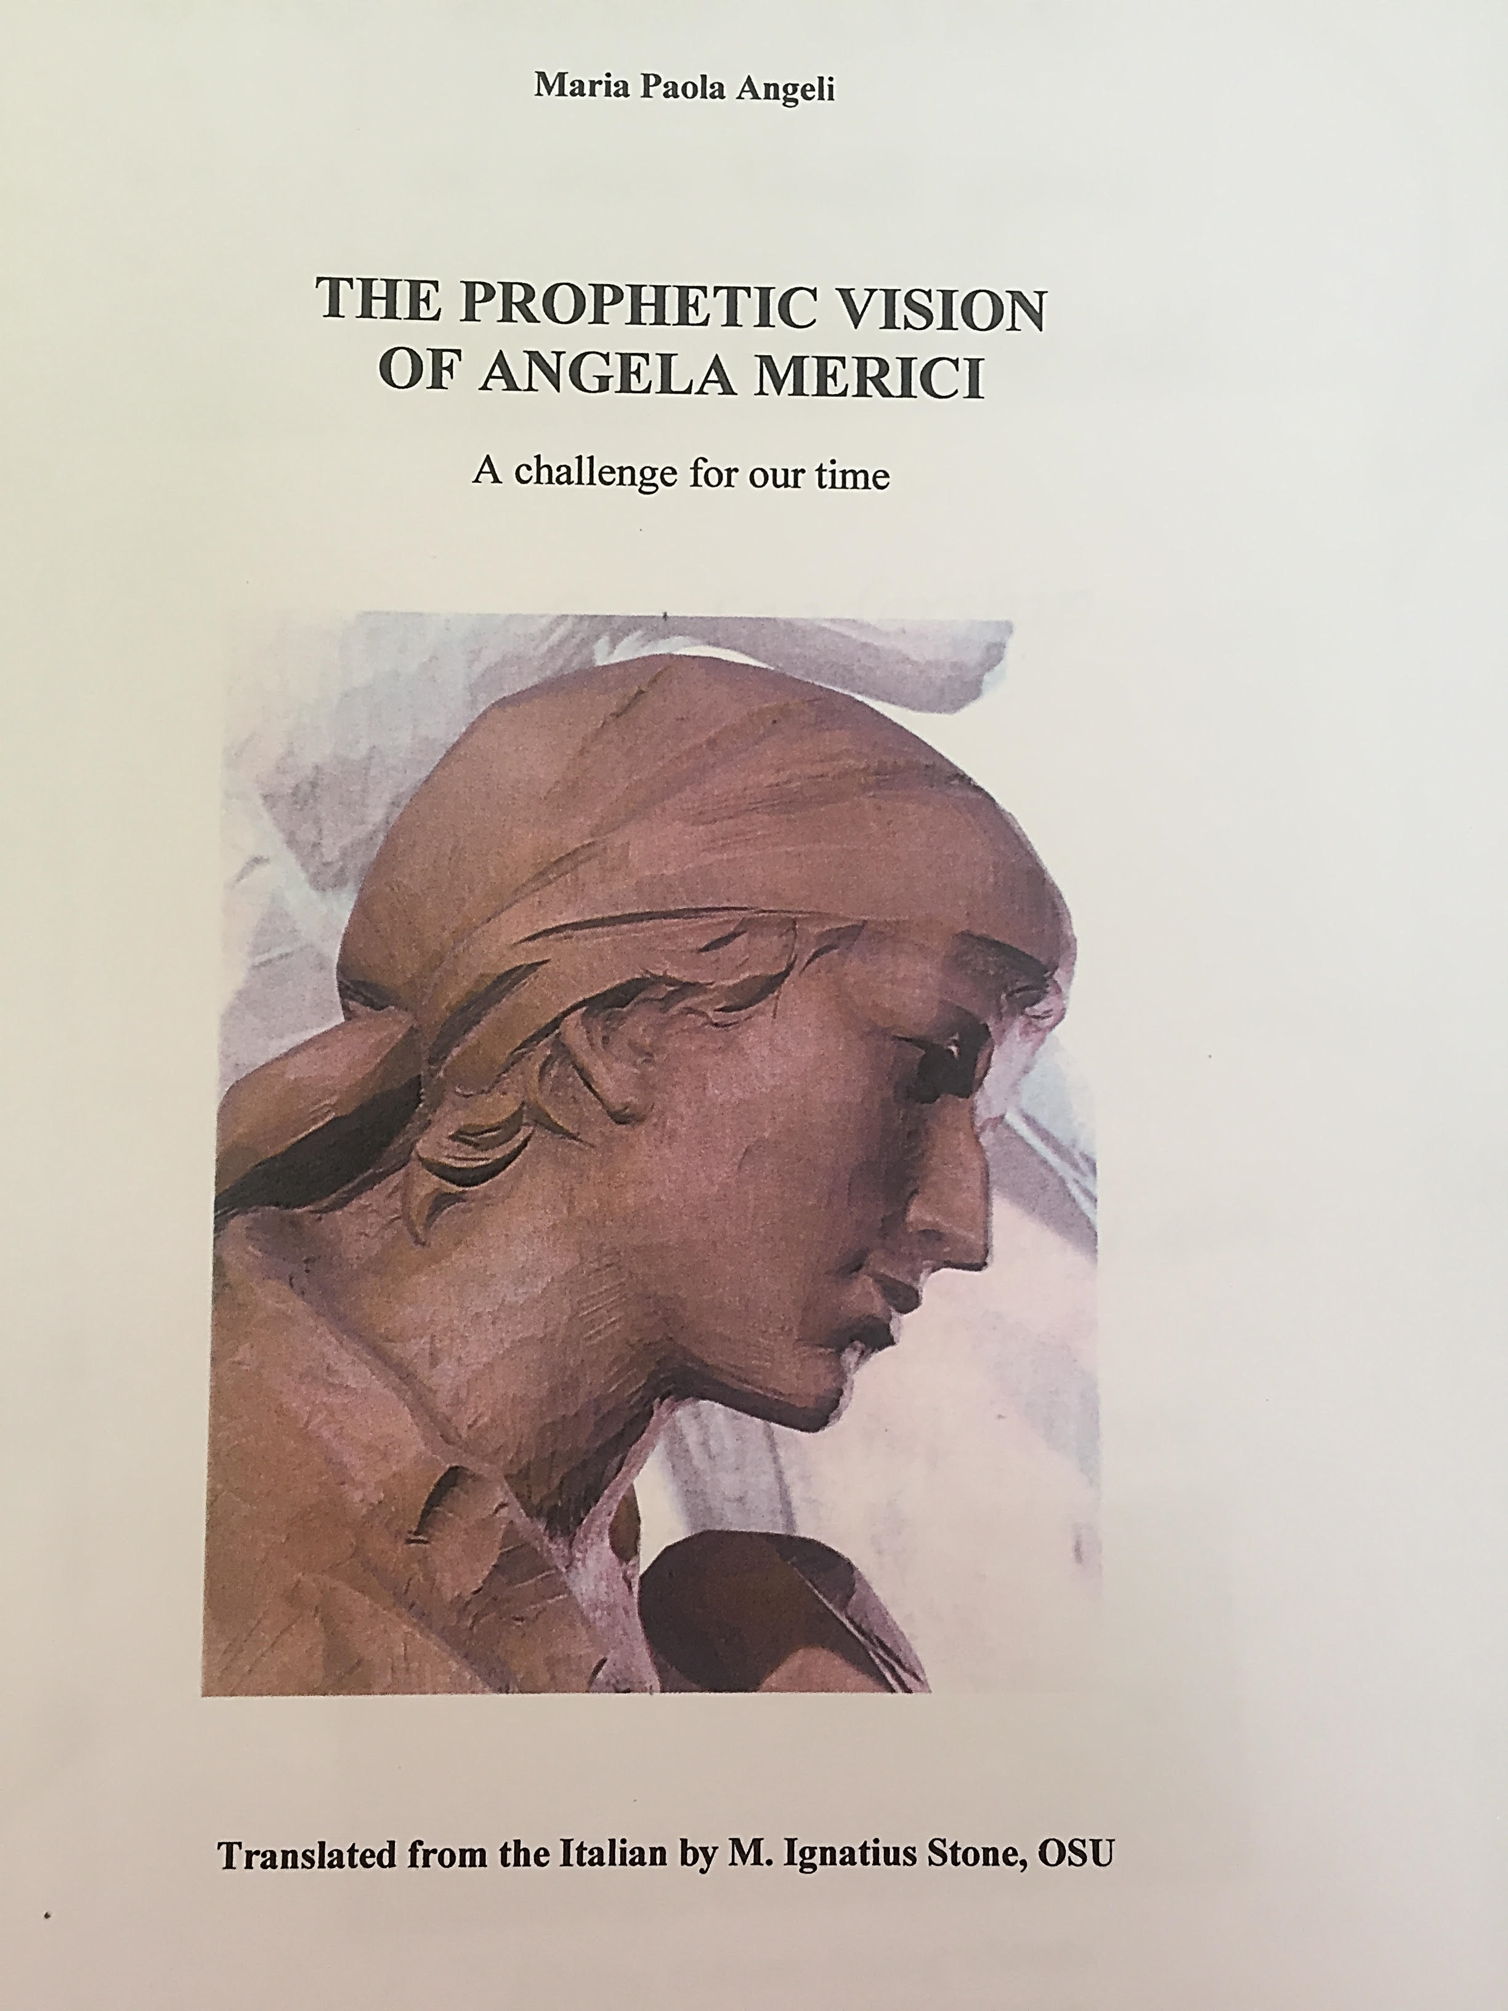
All the quotations in this presentation are taken from this book

Slide 2
Grateful & generous 1
“God has granted you the grace of setting you apart from the darkness of this miserable world and of uniting you together to serve his divine Majesty…. For how many important persons and others of every condition do not have nor will be able to have such a grace” Prologue rule 4,6 – wisdom of being generous and expansive in her thinking about the plight of women in her day and offering a revolutionary idea, free from men, the cloisters
“Be attentive in prayer, with a generous heart and great desire”
“You do not know what he wants to make of them. As for you, do your duty correcting them with love and charity. And after that, leave it to God” 8th counsel, 3, 7, 9. p 36
“And to seek to spread peace and concord wherever they are” 5th counsel 16 p 42

Slide 3
Grateful & generous 2
“I beseech you to have them all engraved on your heart and mind, one by one.” 10th Leg, 11 1-2 p 24
I beg you with all my heart, please be watchful and vigilant, like so many caring shepherdesses, for this heavenly flock entrusted to you hands.” 10th Leg, 11 1-2 p 24

