Slide 1
Laudato Si’
A Prophetic Challenge for the 21st Century
Ursuline Education Community
Mercure Dartford Brand Hatch Hotel
March 6th – 7th 2020

Slide 2
Pope Francis’ encyclical letter on environmental
and economic and evangelical
issues

Slide 3
In fact, the encyclical also deals with poverty,
Climate Change, Chemical Pollution
the destruction of biodiversity,
the pollution of fresh water and the oceans, sustainable food,
extractive industries and
the waste and a throw –away culture created by the global economy and lack of substantial progress on all these issues

Slide 4
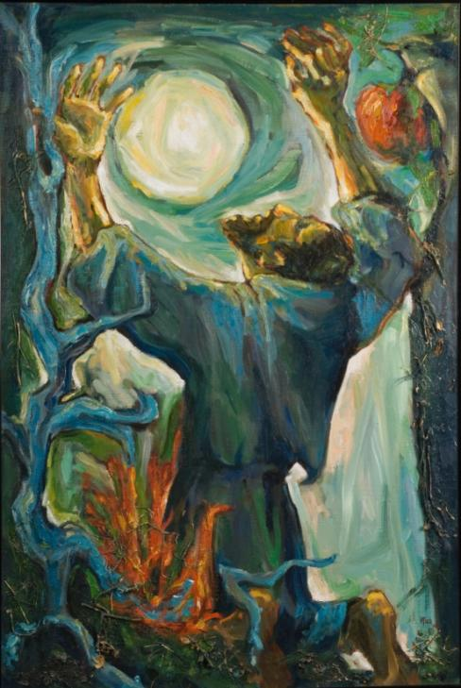
Title drawn from the opening words in the Umbrian dialect of the wonderful
“Canticle of the Creatures”
of St. Francis of Assisi

Slide 5
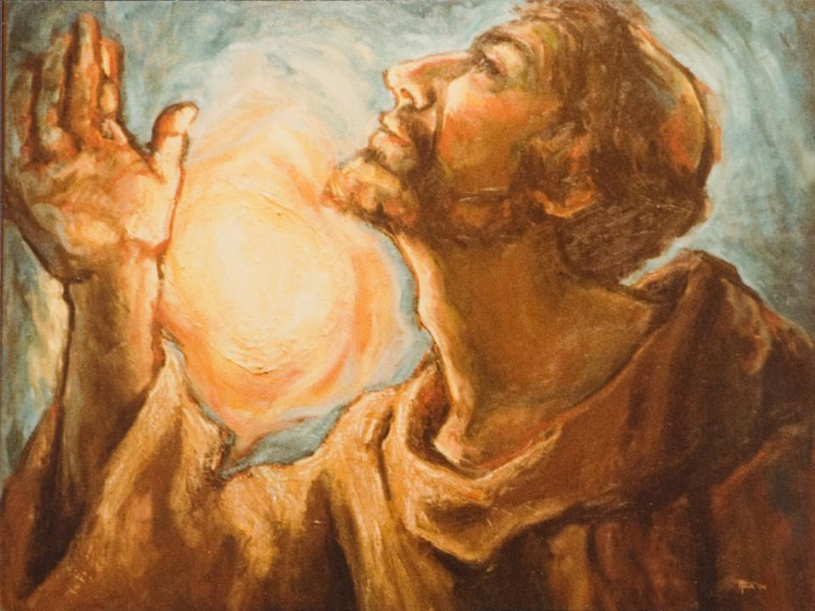
in which the he gives thanks to God for the different creatures and other elements of creation: “Brother Fire,” “Sister Moon,” and “Mother Earth.” (No. 87)

Slide 6
one of the most important documents to come from a pope
in the past one hundred and twenty years -- the era of modern Catholic social teaching.

Slide 7
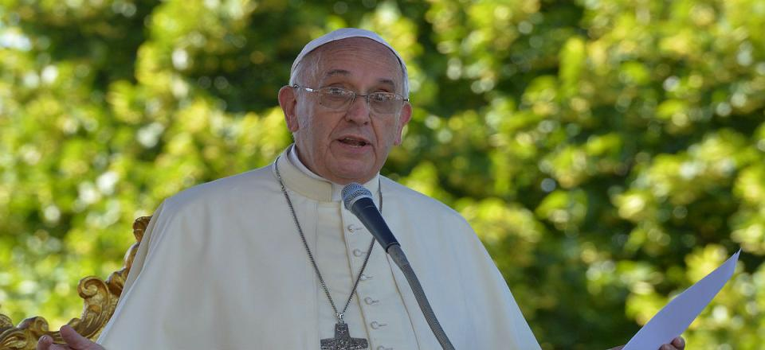
Addressed to every person on the planet about the condition of our common home (No. 3)

Slide 8
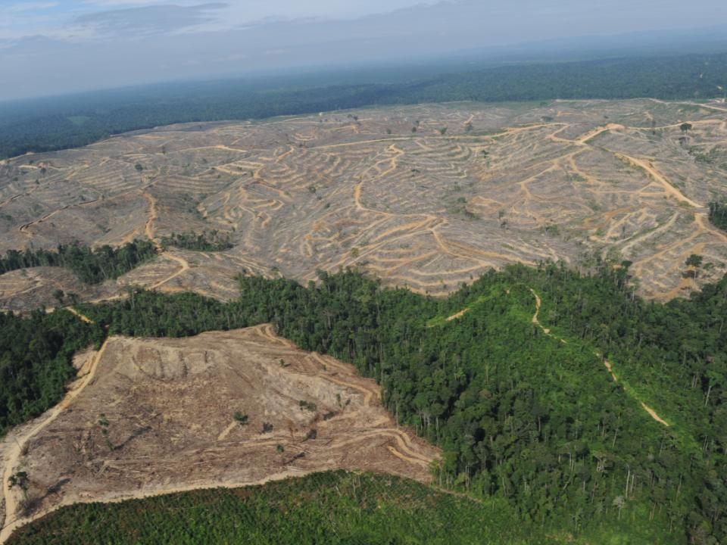
“due to an ill-considered exploitation of nature, humanity runs the risk of destroying it and becoming in turn a victim of this degradation” (No. 4).

Slide 9
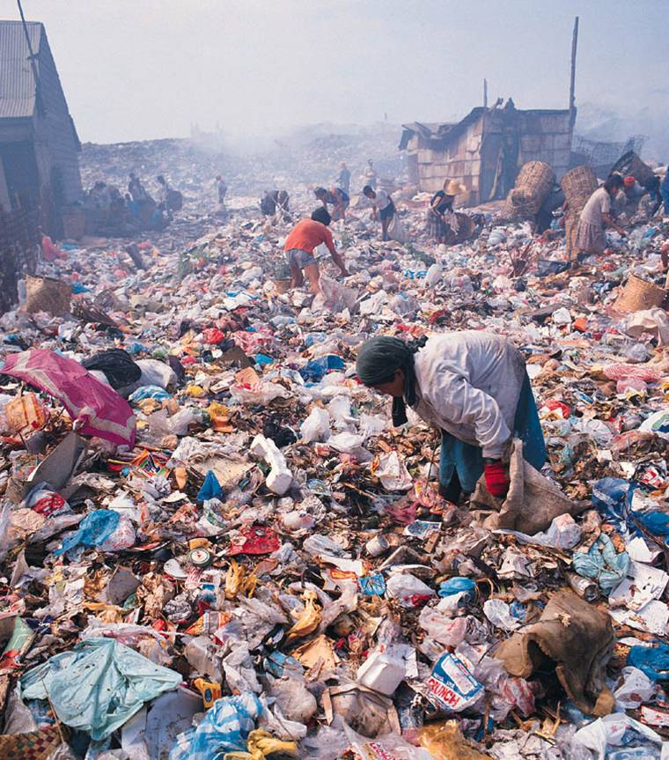
Quite startling language
“the earth, our home, is beginning to look more and more like an immense pile of filth” (No. 21).

Slide 10
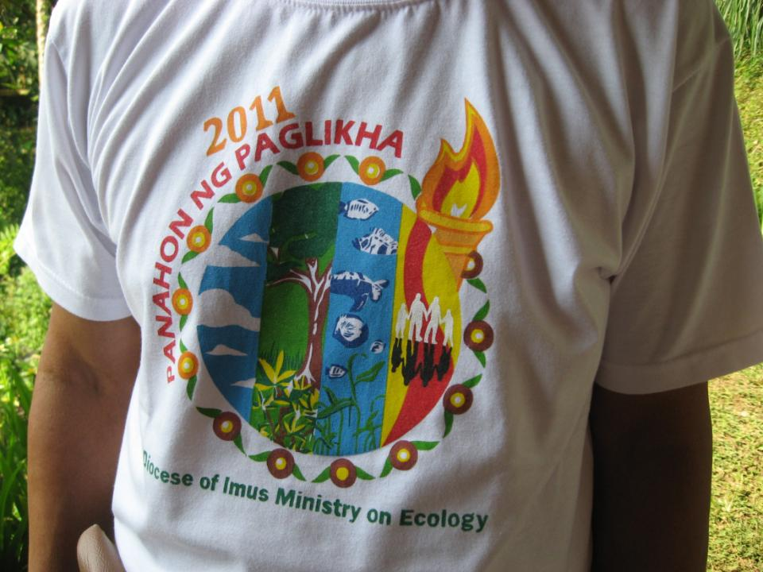
Reminds Christians “that their responsibility within creation and their duties towards nature and the Creator are
an essential part of their faith”
(No. 64)

Slide 11
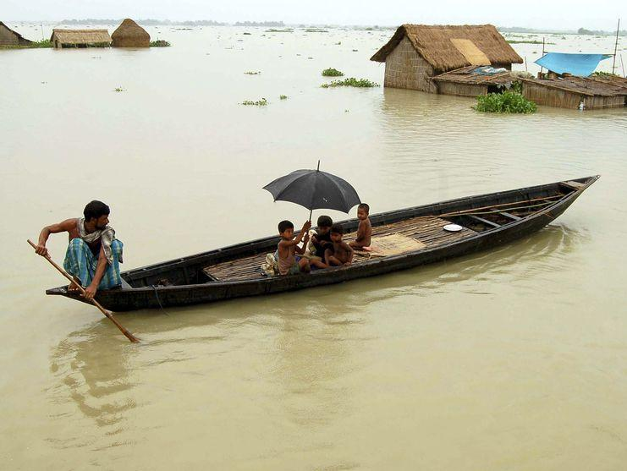
Adamant that there is “an intimate relationship between the poor and the fragile planet” (No. 16).

Slide 12
This document “which is now added to the Church’s social teaching, can help us to acknowledge the appeal, immensity and urgency of the challenge we face” (No. 15).

Slide 13
Laudato Si’ can be compared with three other crucially important social encyclicals which dealt with
the rights of workers,
the threat of nuclear war,
the right to development for poor people.

Slide 14
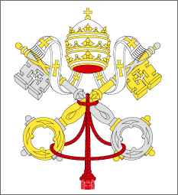
Pope Francis links his concern for the plight of the poor and the devastation of the earth to the teachings of his predecessors:

Slide 15
Laudato Si’ attempts to avoid this anthropocentric focus: an extraordinary breakthrough in Catholic creation theology

Slide 16
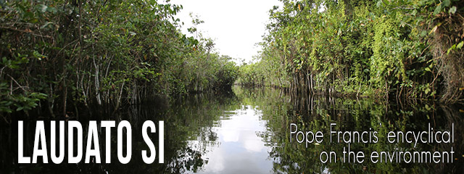
the first papal document to understand the magnitude of ecological destruction taking place globally and the urgency with which it must be faced.

Slide 17
The Compendium of the Social Doctrine of the Church (2004) does not contain the sense of ecological crisis which is so evident in Laudato Si’.
Its Ch. 10, devoted to “Safeguarding the Environment” = 15 pages while Ch. 6 on “Human Work” = 26 pages.

Slide 18
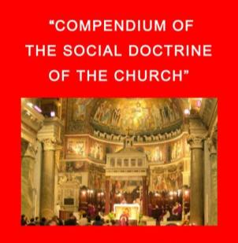
on climate change: ½ par (No. 470)
on biodiversity: ½ par (No 466)
on biotechnology: 9 par

Slide 19
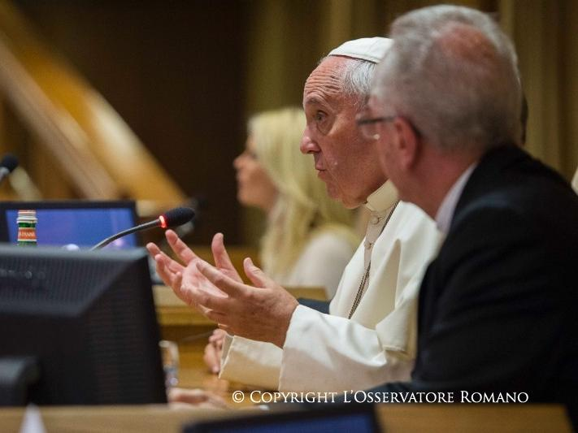
Other Voices
One major change in Pope Francis’ style as Bishop of Rome -- which has enormous implications for ecclesiology -- he is willing to include other voices

Slide 20
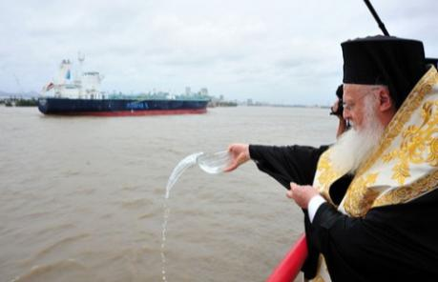
The first voice in Laudato Si’ comes from the Ecumenical Patriarch Bartholomew, who has constantly focused on protecting God’s creation,
especially the water bodies of the world, since his election as Patriarch in 1991.

Slide 21
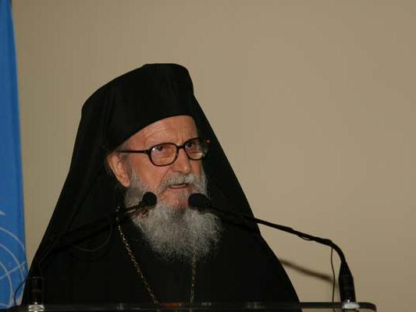
The Patriarch focuses on the moral responsibility to protect creation:

Slide 22
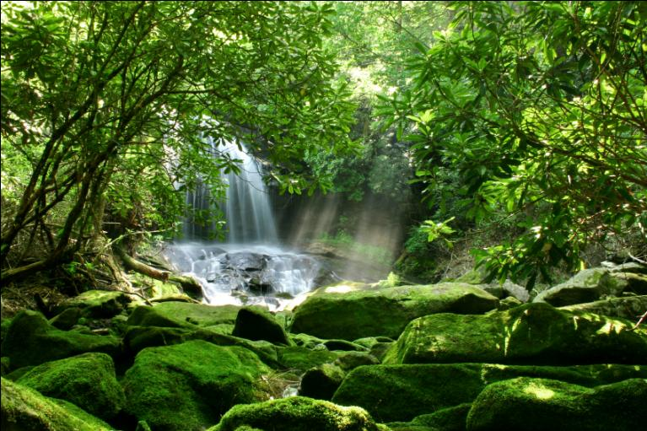
“For human beings… to destroy the biological diversity of God’s creation;

Slide 23
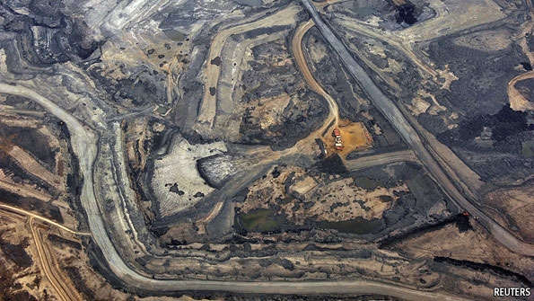
for human beings to degrade the integrity of the earth by causing changes in its climate, by stripping the earth of its natural forests or destroying its wetlands;

Slide 24
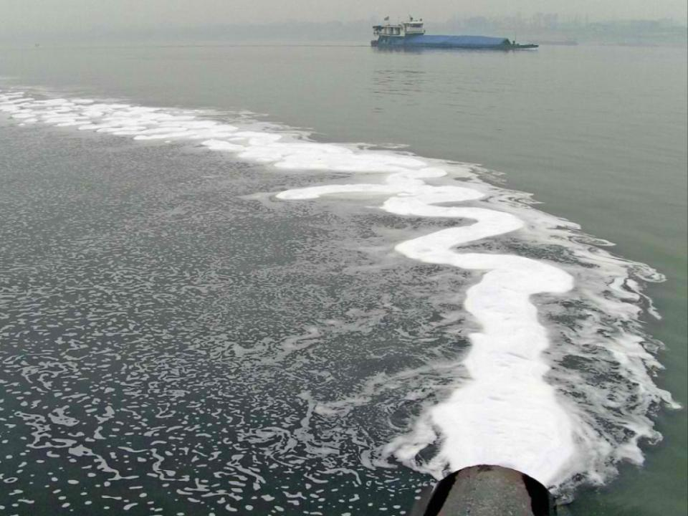
for human beings to contaminate the earth’s waters, its land, its air, and its life –

Slide 25
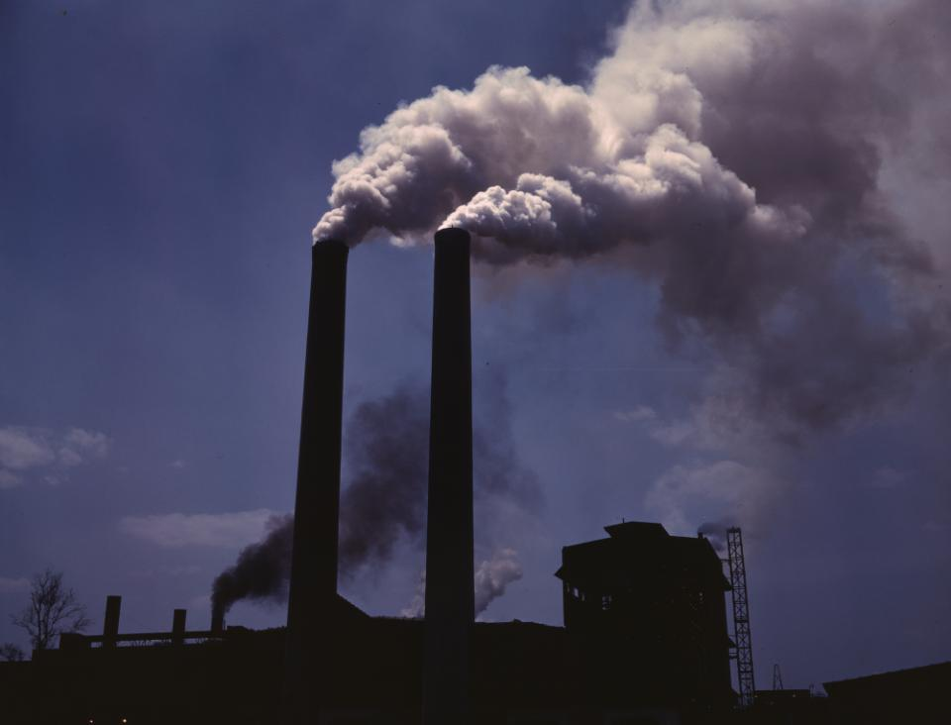
- these are sins”.

Slide 26
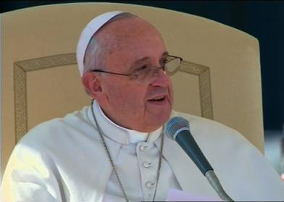
On August 6, 2015, the Feast of the Transfiguration,
Pope Francis announced
September 1 as World Day of Prayer for the Care of Creation.In other Churches Creation Times last through September till the feast of St. Francis

Slide 27
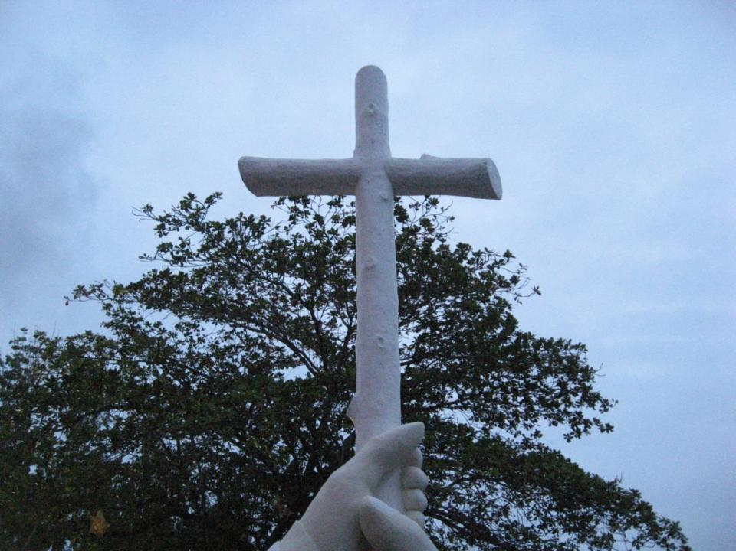
The pope believes that Christians from every tradition are now being called upon to offer their own contribution to overcoming the ecological crisis which is facing planet earth today. Probably should have mentioned the World Council of Churches (WCC).

Slide 28
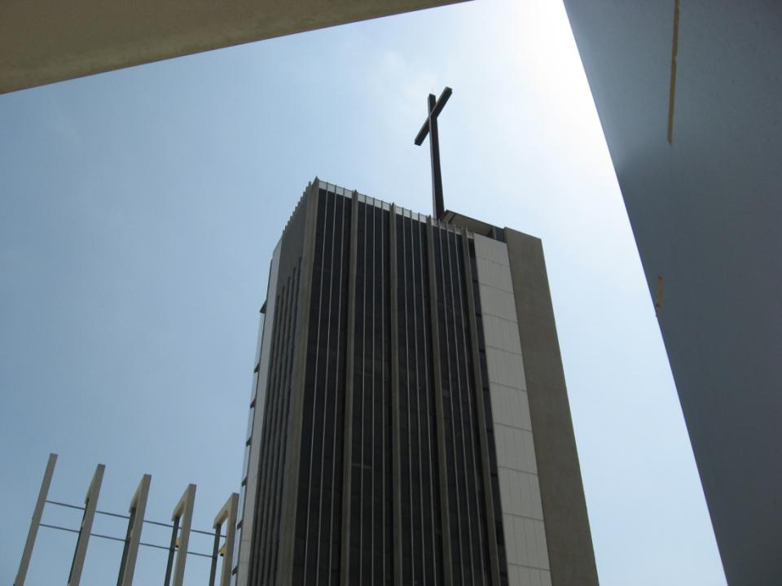
This is both
a new spirituality
and new moral teaching which previous generations of Christians did not have to deal with.

Slide 29
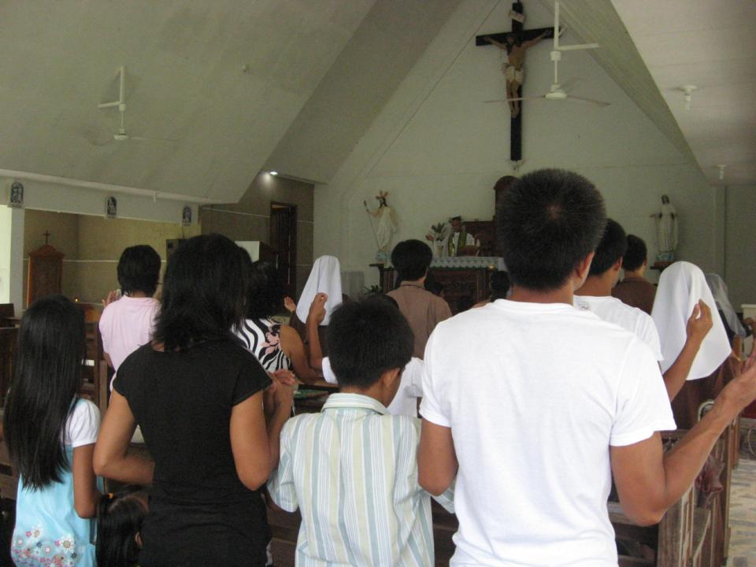
For most of the 2,000-year history of the Christian faith, focus was on human relationships with God and other human beings.

Slide 30
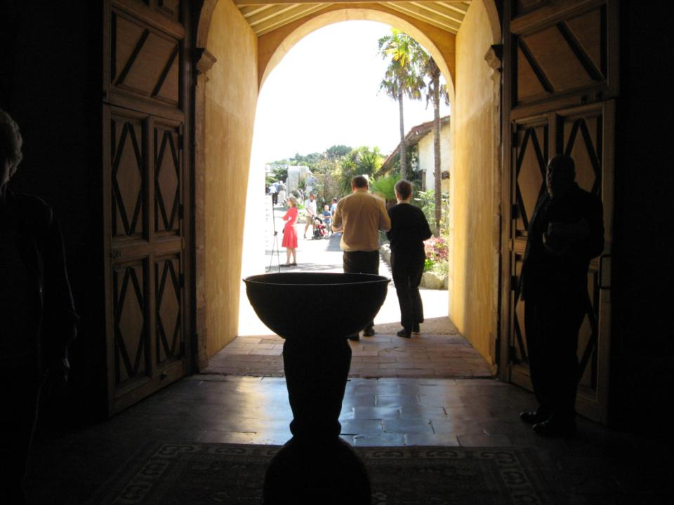
Christians knew it was wrong to worship false gods, to kill, to steal, to commit adultery, or to lie.

Slide 31
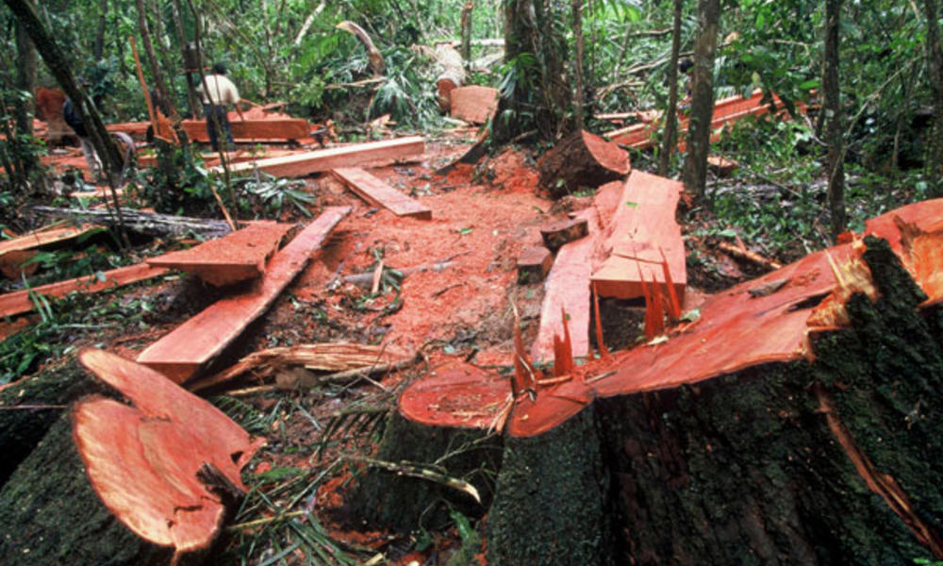
However the majority of Christians never thought it was wrong to devastate forests or to drain marshes.

Slide 32
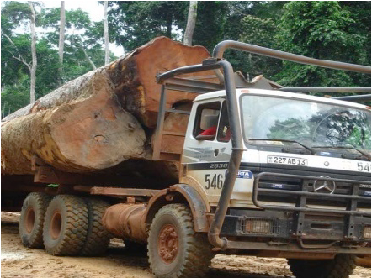
Those who ploughed up the prairies of North America, or cut down the forests of Ireland, or used mercury for mining purposes in Australia, or devastated the tropical forests in the Philippines during the 1960s and 1970s, did not think of what they were doing as morally wrong.

Slide 33
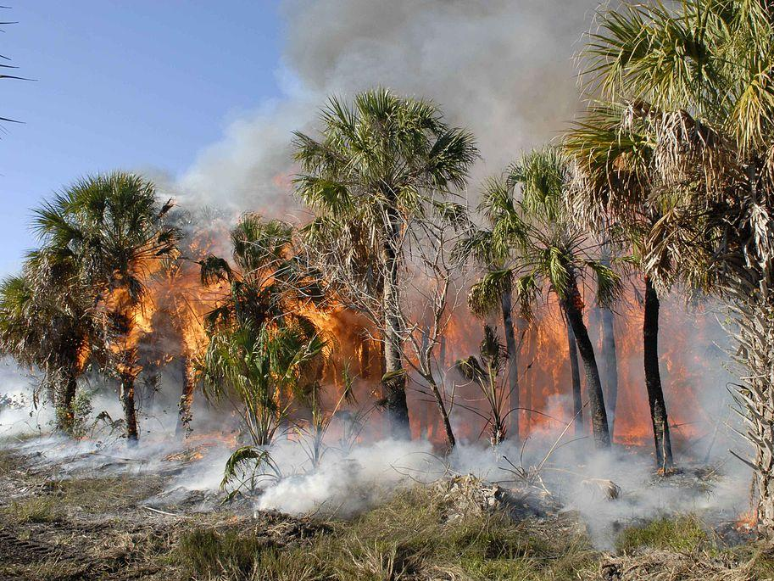
It is only during the past few decades that such actions have been considered sins.

Slide 34
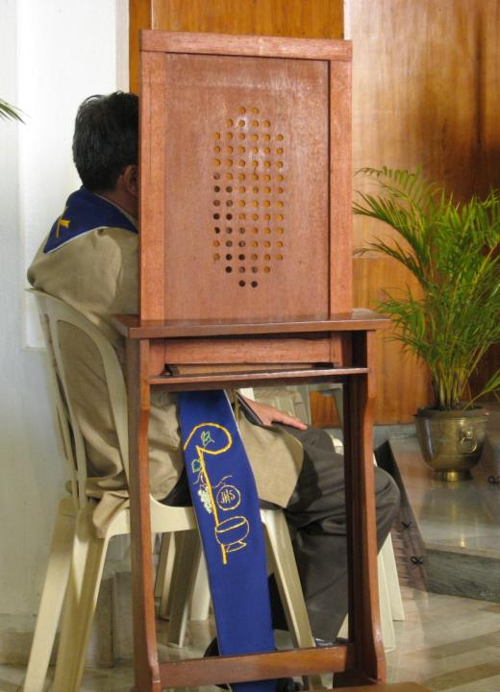
Even today many Catholics would not think of including such behaviour in their celebration of the sacrament of penance.

Slide 35
if Laudato Si’ is to have a profound, long-lasting influence on Catholic Social and Ecological teaching it will need to be followed up with systematic and extensive moral catechesis aimed at bringing about the serious changes which are envisaged in Laudato Si’.

Slide 36
H
In 2019 Pope Francis said he would include ecological sin in the Catechism

Slide 37
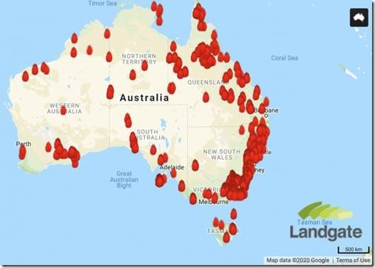
We are very homocentric. In covering the bushfires in Australia the media focuses on the fact that 40 humans lost their lives and forgets that 25,000 koalas have been killed and a half-a-billion other animals

Slide 38
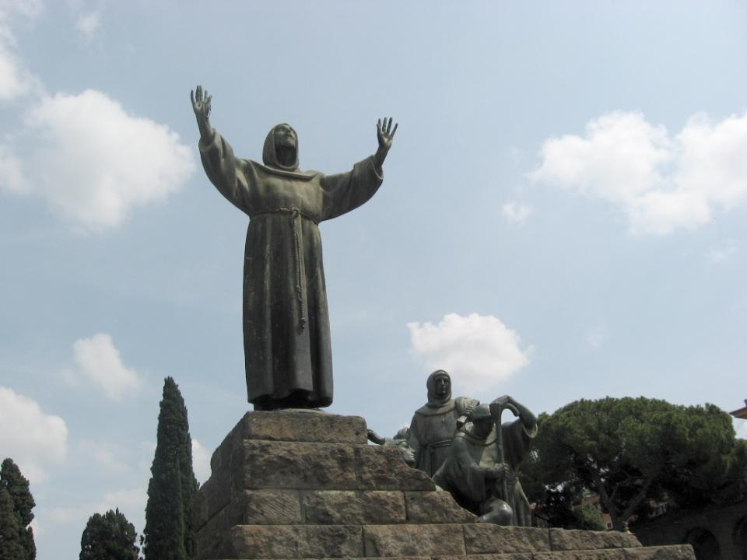
St. Francis of Assisi

Slide 39
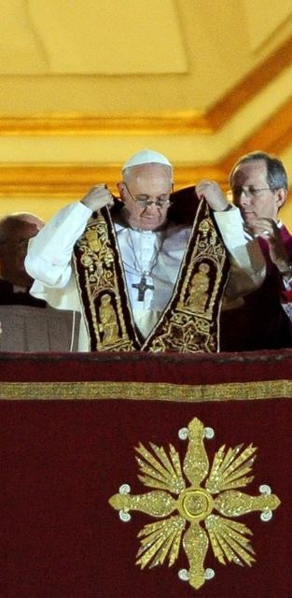
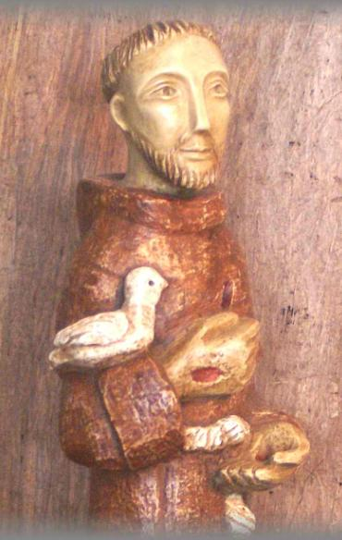
Pope Francis acknowledges his devotion to St. Francis
I do not want to write this Encyclical without turning to that attractive and compelling figure, whose name I took as my guide and inspiration when I was elected Bishop of Rome. (No. 10)

Slide 40
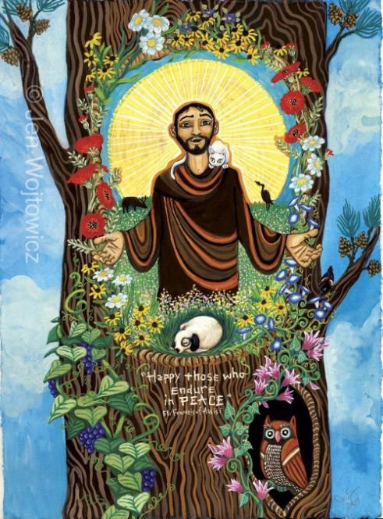
In the encyclical the Pope constantly emphasizes the inseparable bond between
concern for nature,
justice for the poor,
commitment to society,
and interior peace
(No. 11)

Slide 41
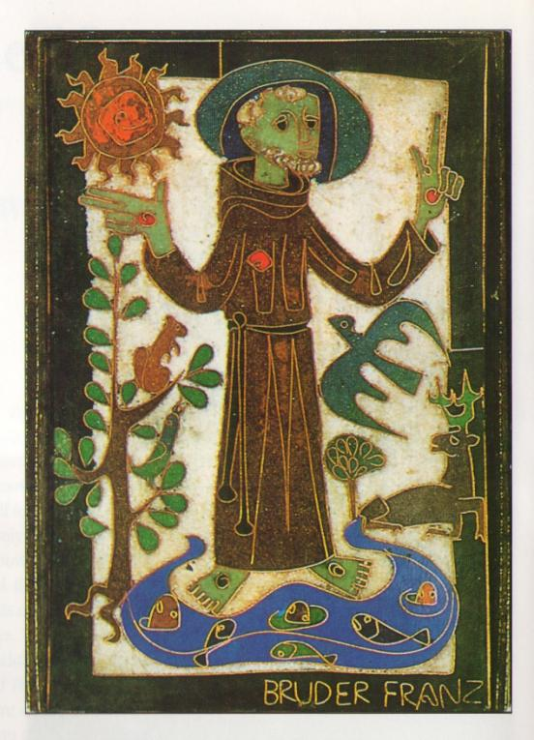
a bond exemplified by St. Francis, who “communed with all creation, even preaching to the flowers, inviting them ‘to praise the Lord,’ just as if they were endowed with reason (No. 11).

Slide 42
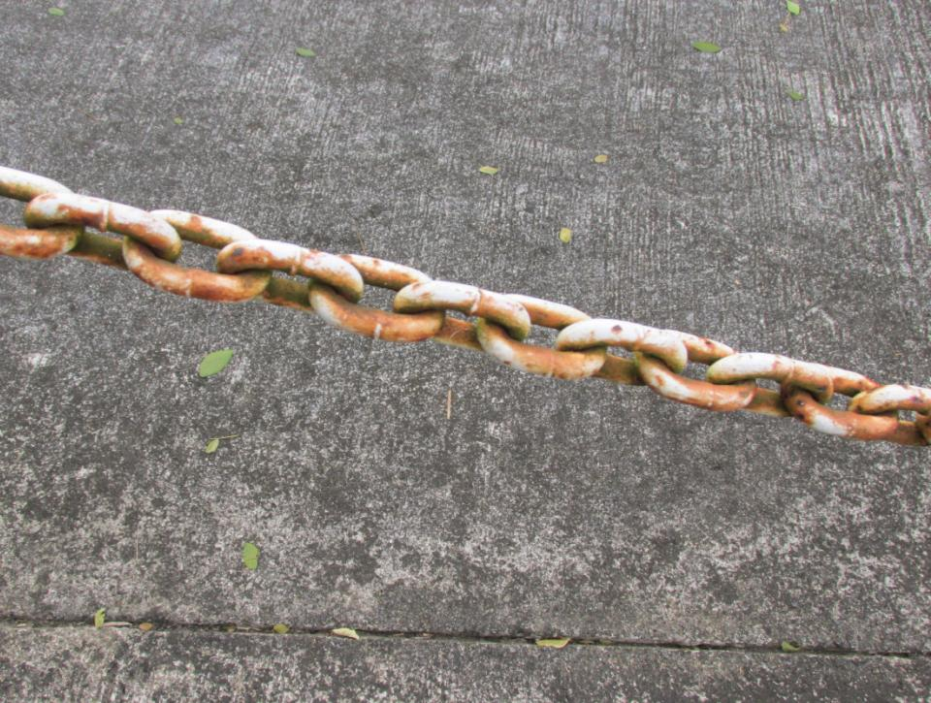
Anti-body
and
Anti-creature
Sentiments

Slide 43
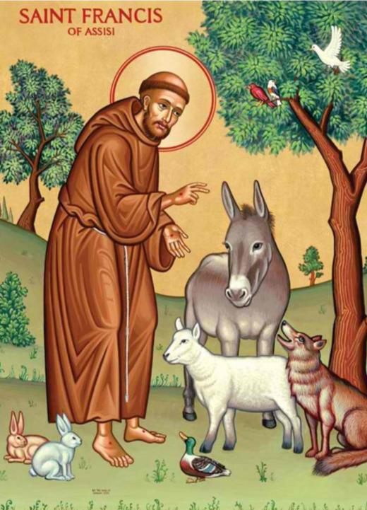
It would be nice to suppose that the vision of St. Francis, especially his fraternal relationship with all creation had continued and blossomed during the centuries after his death.

Slide 44
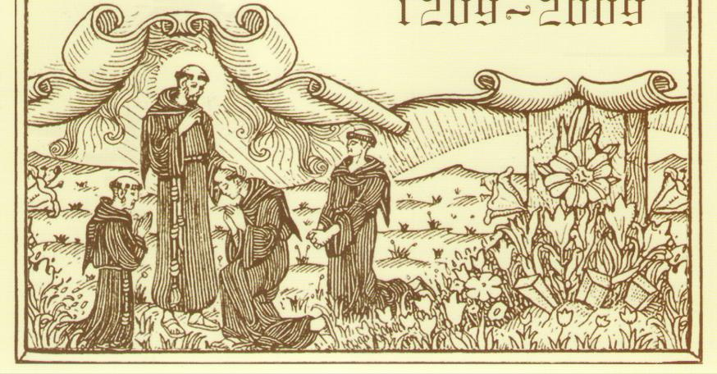
Unfortunately, this did not happen. In fact, the opposite occurred; the creation-centered focus of Francis’ vision was lost, even among the Franciscans.

Slide 45
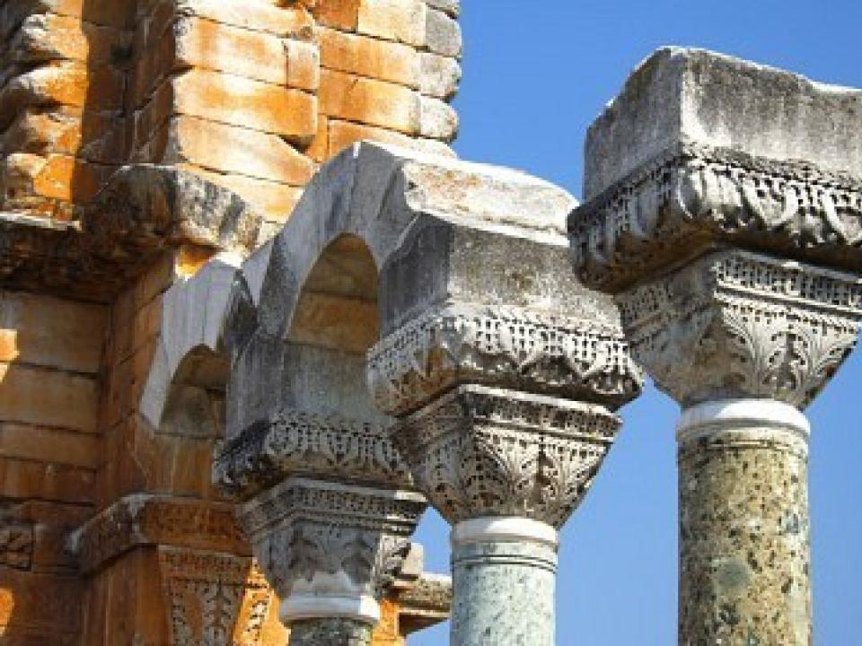
Some of the blame is traced to the hierarchical dualism which early Christian theology adopted in its encounter with the Hellenistic world which predated Francis by hundreds of year. Neoplatonism

Slide 46
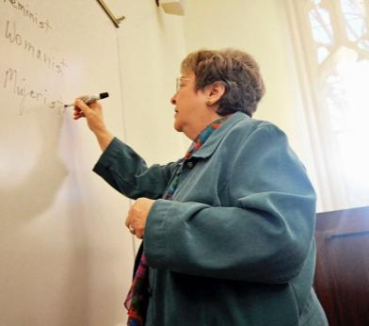
“This influential thought pattern not only sees the world in terms of the polarities of spirit and matter, but also prizes spirit as closer to the divine realm.”
(Elizabeth A Johnson, “Is God’s Charity Board Enough for Bears,” The Irish Theological Quarterly, (2015: Pontifical University Maynooth, p 284.)

Slide 47
Late medieval distinction between natural and supernatural which was designed to protect the gratuity of graces, focused so much on the supernatural that “it leached the presence and action of God in what was ‘merely’ natural.”

Slide 48
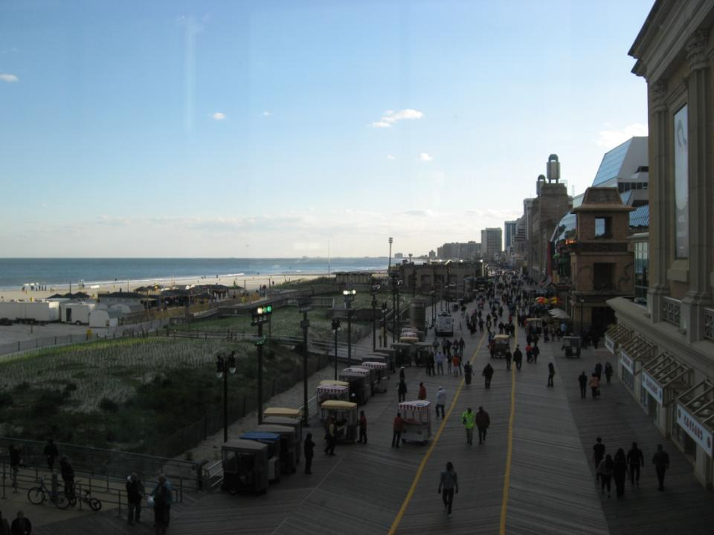
“The world became no longer a gift but just a given, a background for the human drama.” (Ibid)

Slide 49
This pessimistic, anti-world mood period was further strengthened by the extraordinary Europe-wide trauma of the Black Death (1346–1353),
one of the most devastating pandemics in human history.

Slide 50
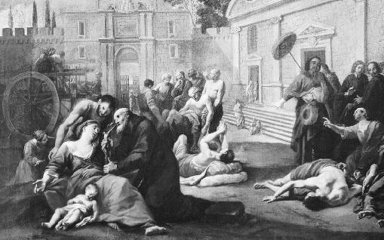
It claimed the lives of between 75 and 200 million people, or between 30 to 60 percent of Europe’s population.

Slide 51
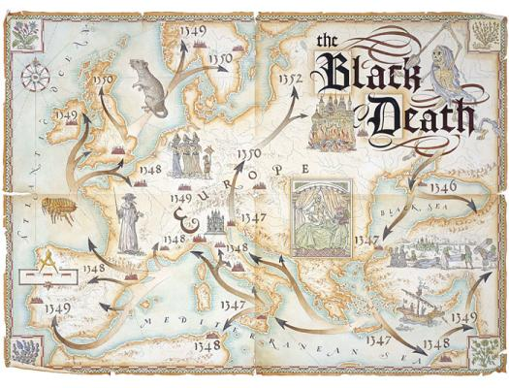
Because of the speed of its transmission and the vast numbers of people affected,
it sparked a series of religious, social, and economic upheavals which had a profound effect on the course of European history.

Slide 52
Clerical sermons in the wake of the plague interpreted it as a punishment from God. The only protection was to embrace a spirituality based on prayer, asceticism, mortification, and a withdrawal from engagement with the world.
Creation, as such, had no value.

Slide 53
Concern for creation was further diminished by the Reformation’s almost exclusive focus on human salvation.

Slide 54
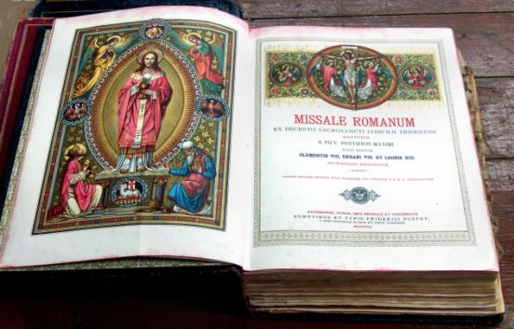
The negative attitude to creation was also present in the missal of Pope Pius V, which was used right up to the Second Vatican Council.

Slide 55
The post-communion prayer during Advent read as follows,
“Domine, doceas nos terrena despicere, et amara celestia”
(“Lord, teach us to despise the things of earth, and to love the things of heaven.”)

Slide 56
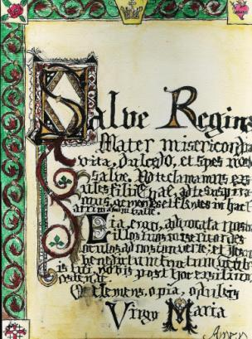
The same lack of appreciation for the beauty and value of creation is expressed in the prayer Salve Regina which refers to the condition of human beings in this life,
“mourning and weeping in this valley of tears.”

Slide 57
If our true home is in heaven and this world is just a valley of tears, all our energies need to be devoted to our interior life.

Slide 58
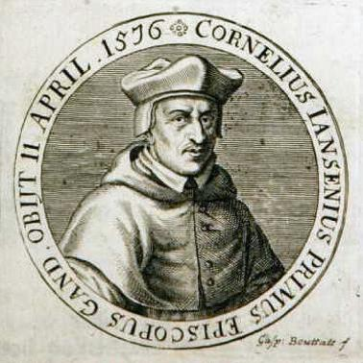
In the Catholic Church, Jansenism, an important theological movement in France in the 17th and 18th centuries,
paid little attention to the importance of creation in the life of the believer.

Slide 59
Their teaching focused again on original sin, human depravity, the necessity of divine grace, and predestination. Though condemned by Pope Clement IX and Pope Clement XI, ideas tinged with Jansenism made it difficult to highlight the revelatory aspect of creation.

Slide 60
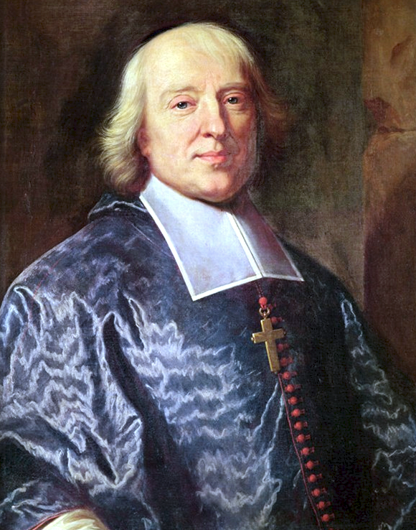
Bishop Jacques Bossuet Bishop of Meaux (1627 to 1704).
Bishop
He encouraged his fashionable congregations to exercise distain for the world mépris due monde m the world.
Patrick H Daly, The Voice of the Bishop in the Public Square , The Furrow, March 2016, page 140
Notes:
T

Slide 61
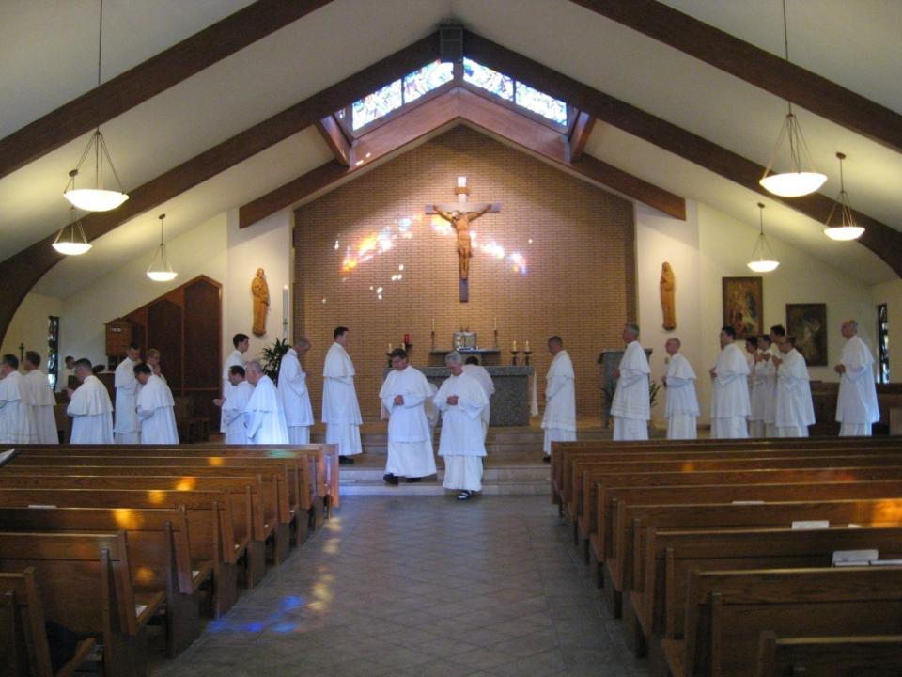
With all these influences acting together, an anti-body/anti-other creature bias dominated the spiritual literature circulated
in religious houses of formation right up to the time of the Second Vatican Council in the 1960s.

Slide 62
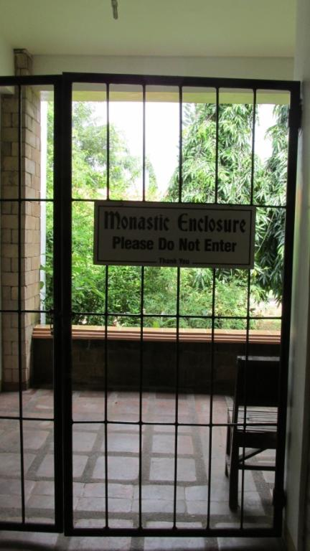
Spirituality gave priority to the salvation of one’s soul and the future life in heaven, rather than being involved in the affairs of the world.

Slide 63
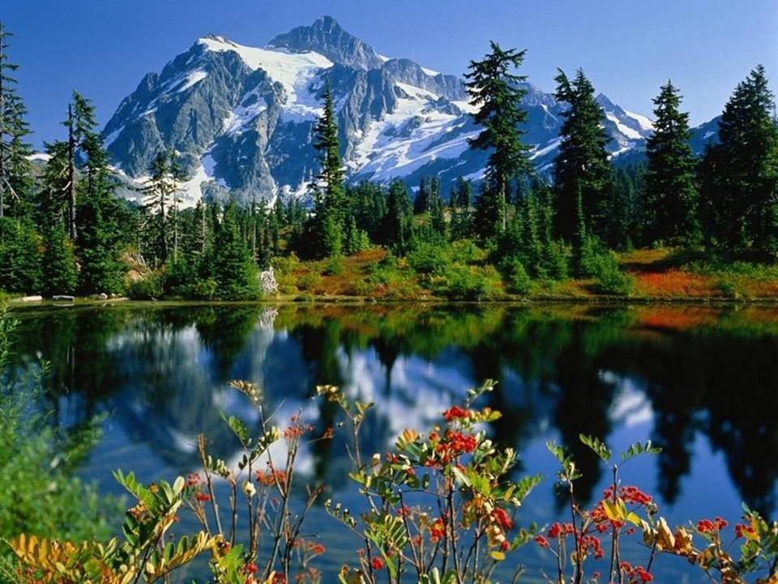
Not everyone viewed creation in such a negative way. There were saints such as John of the Cross who felt that
“Mountains have heights and they are plentiful, vast, beautiful, graceful, bright and fragrant.
These mountains are what my Beloved is to me.
(LS 234 quoting St. John of the Cross)

Slide 64
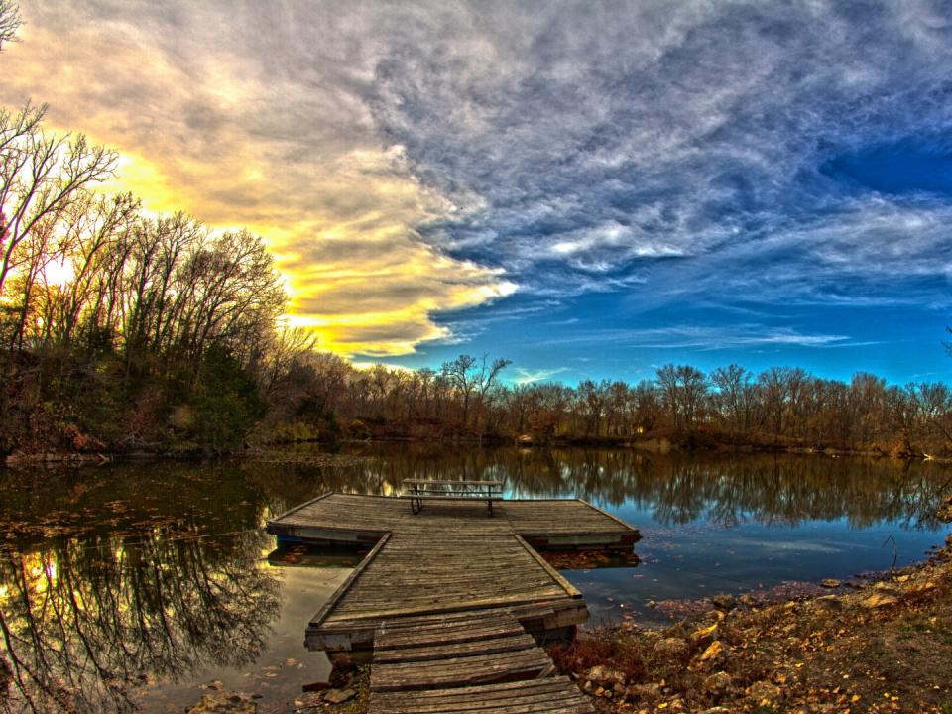
But,
such
voices
were
exceptions.

Slide 65
Many Christians, especially in the second millennium, had a much more jaundiced view, and did not always respect the earth.
Pope Francis acknowledges this:

Slide 66
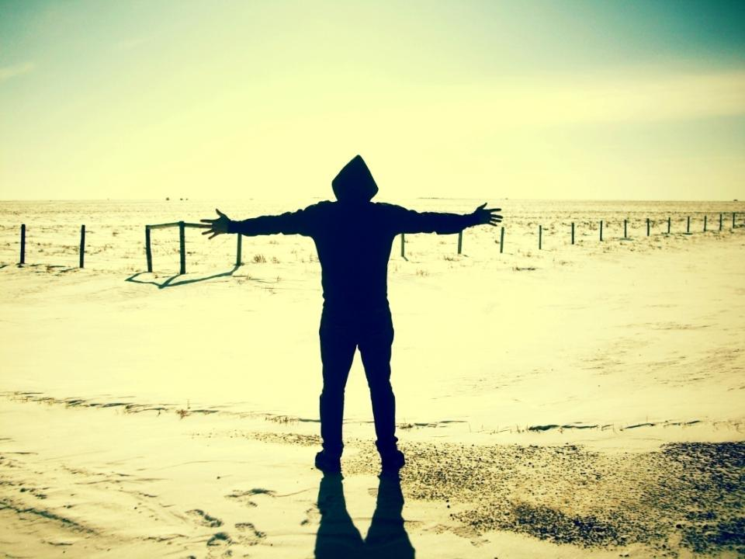
If a mistaken understanding of our own principles has at times led us
to justify mistreating nature,
to exercise tyranny over creation,
to engage in war, injustice and acts of violence,

Slide 67
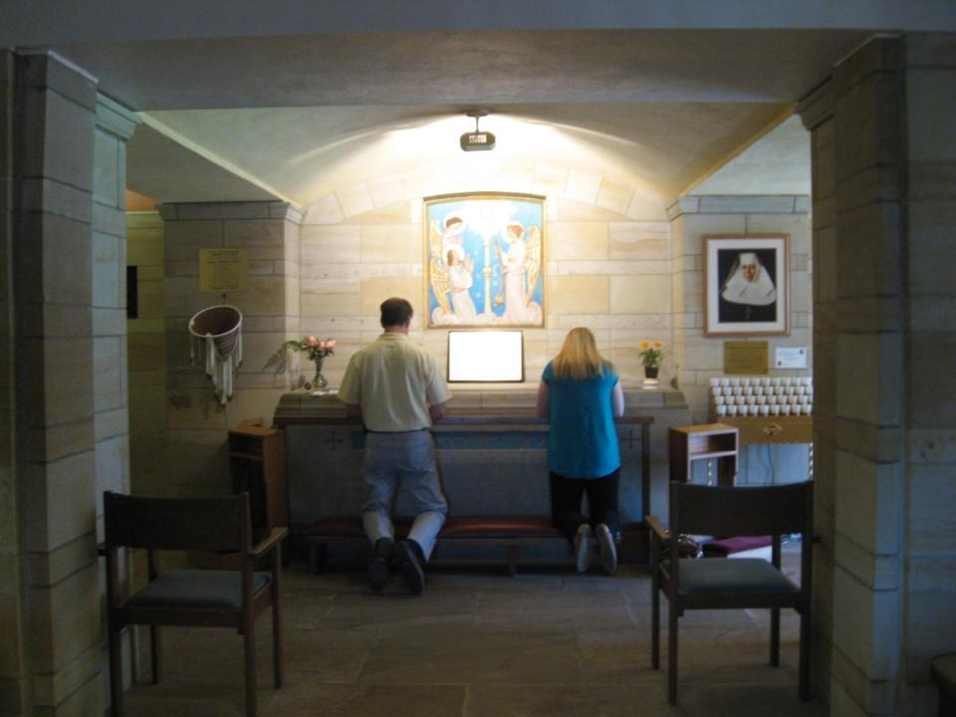
we believers should acknowledge that by so doing we were not faithful to the treasures of wisdom which we have been called to protect and preserve. (No. 200)

Slide 68
The Book of Genesis

Slide 69
Pope Francis develops his own theology of creation.
Many of the quotations are taken from the Bible.

Slide 70
He begins by reviewing the creation stories from Genesis, finding there an affirmation of the goodness of the world, while also countering interpretations that are commonly invoked to justify a spirit of domination over nature.

Slide 71
The first chapter of the book of Genesis tells us that the world was created by a loving, personal God.

Slide 72
The world is good in itself; God contemplates what he has done and found that ‘it was good’ (Gen 1:10, 13, 18, 21, 26).

Slide 73
“After the creation of man and woman, ‘God saw everything that he had made, and behold it was very good.” (Gen.1:31).

Slide 74
“Let us make man in our own image, in the likeness of ourselves, and let them be masters of the fish of the sea, the birds of heaven, the cattle, all the wild beasts and the reptiles that crawl upon the earth…. God blessed them, saying to them, 'Be fruitful, multiply, fill the earth and conquer it.’” (Gen 1:26-28)

Slide 75
The repercussions of this command “to fill the earth and conquer it” (Gen 1:28) have had a profound impact on the way Jews and Christians have related to the natural world.

Slide 76
The New Jerusalem Bible uses the phrase: “subdue it,” while other translations say “have dominion over it.”

Slide 77
Pope Francis is aware that “the Genesis account which grants man ‘dominion’ over the earth, has encouraged the unbridled exploitation of nature by painting him as domineering and destructive by nature.” (No. 67)

Slide 78
“this is not a correct interpretation of the Bible as understood by the Church”
(No. 67).

Slide 79
In Genesis 2:15, God commands Adam and Eve to “till and keep” the garden of the world.
“Tilling” refers to cultivating, plowing, while “keeping” means, caring, protecting, overseeing and preserving”
(No. 67).

Slide 80
For the Pope this text calls on humans to be thoughtful and careful in the way they relate to creation,
though he does admit that

Slide 81
“It is true that we Christians have at times incorrectly interpreted the Scriptures;
nowadays we must forcefully reject the notion that our being created in God’s image and given dominion over the earth justifies absolute domination over other creatures.” (No. 67)

Slide 82
The Pope joins with modern biblical scholars who insist that the Divine command in Genesis chapter 1:28 cannot be interpreted as a license for humans to change and transform the natural world according to any human whim or fancy.

Slide 83
The dominion given in Genesis 1:28 is, in fact, a challenge to human beings to imitate God's loving kindness and faithfulness and to act as his viceroy in relationship with the non- human component of the earth.

Slide 84
Like viceroys of the king, men and women were expected to be just and honest and to render real service.
They were forbidden to exploit the people or the earth.

Slide 85
Exegetes remind us that the first account of creation does not end at Genesis 1:31 with the creation of humans. It ends rather in Genesis 2:3 with the Sabbath rest of God.

Slide 86
The Sabbath was a very important institution for the people of Israel, both for the well-being of humans and other creatures.

Slide 87
Pope Francis highlights the importance of the Sabbath, as a time of rest for everyone, and the Jubilee, as a way of distributing the goods of creation (No. 71).

Slide 88
Genesis as Understood from the 16th to the 19th centuries we need to consult historians

Slide 89
Although contemporary scripture scholars agree with the Pope, this argument faces an uphill battle against centuries of interpretation to the contrary.

Slide 90
In Tudor and Stuart England, for example, the biblical teaching on “dominion” over creation was interpreted in just this way.

Slide 91
The Bible taught that:
“the world had been created for man’s sake and that other species were meant to be subordinate to his wishes and needs…
those theologians and intellectuals who felt the need to justify it could readily appeal to the classical philosophers and the Bible.

Slide 92
“Nature made nothing in vain, said Aristotle, and everything had a purpose. Plants were created for the sake of animals and animals for the sake of man. Domestic animals were there to labor, and wild ones to be hunted. The Stoics had taught the same: nature existed solely to serve man’s interests.” (Keith Thomas, Man and the Natural World: A History of the Modern Sensibility, (New York: Pantheon Books, 1983), 17.)

Slide 93
This anthropocentric and mechanistic and secular vision of creation was of course not confined to people like Francis Bacon (1561 – 1626) and Isaac Newton (1642 -1727) in Britain.

Slide 94
The French philosopher René Descartes (1596- 1650) believed that “man stood to animal as did heaven to earth, soul to body, culture to nature.
There was a total qualitative difference between man and nature.” (Ibid., 35.)

Slide 95
Aware of this history, Pope Francis points out that “unhealthy dualism, nonetheless, left a mark on certain Christian thinkers in the course of history and (as a result) disfigured the Gospel” (No. 98).

Slide 96
When Laudato Si was published on June 18th 2015, many people turned immediately to look at what the document had to say about climate change.

Slide 97
Pope Francis was clear and unambiguous; “a very solid scientific consensus indicates that we are presently witnessing a disturbing warming of the climate system” (No. 23).

Slide 98
Climate change was not mentioned in Pope Benedict’s encyclical Caritas in Veritate (Love in Truth), published just a few months
before the United Nations Framework Convention in Copenhagen in December 2009.

Slide 99
The central theme of an encyclical which links the plight of the poor and the care of earth is taken up here as well when he claims that
Its worst impact will be felt by developing countries in coming decades. (No. 25)

Slide 100
Australian Bushfires 2019- 2020
The recent bushfires in Australia in 2019-20 were exacerbated not only by global warming

Slide 101
A woman look out her window as geese swim past after the Severn burst its banks in Bewdley, west of Birmingham, England in February 2020

Slide 102
Pope Francis puts it more graphically:
Biodiversity
“The earth’s resources are also being plundered because of short-sighted approaches to the economy, commerce and production.”
(No. 32)

Slide 103
Pope Francis realizes that the current extinction of 100,000 species each year is a direct result of human activity on the planet (No. 33).
The extinction rate in the 20th century is up to 10000 times higher than it would have been without human activity.

Slide 104
“The quenching of life’s exuberance will be more consequential to humanity than all present day warming, ozone depletion and pollution combined.”
Edward O Wilson, “Vanishing Before Our Eyes,” Time Special Edition, April/May 2000, p. 30.

Slide 105
A study in 2010 by The International Union for the Conservation of Nature (IUCN), estimates that
one in five mammals,
one in four plants,
one in three amphibians and
one in eight birds
are in danger of being pushed over the precipice of extinction.

Slide 106
These are conservative projections
and do not take account of the number of species which will become extinct because of global warming.

Slide 107
The destruction of biodiversity by human beings ignores the fact that all these creatures have
“intrinsic value in themselves independent of their usefulness.

Slide 108
“Each organism, as a creature of God, is good and admirable in itself; the same is true of the harmonious ensemble of organisms existing in a defined space and functioning as a system.” (No. 140).

Slide 109
This is certainly new teaching and it has enormous implications for Christians living in our world today.

Slide 110
If each species has intrinsic value, we humans are challenged to be attentive to them and their habitat, so that humans and all other creatures can thrive on earth.

Slide 111
This kind of attentiveness to creation would become the foundation stone of our creation spirituality.

Slide 112
From this perspective, protecting biodiversity should be one of the primary goals of human life, the central human vocation.

Slide 113
The Catholic Church which presents itself as a pro-life Church, should take a special interest in the UN Convention on Biodiversity in Kunming in China in October 2020.

Slide 114
In Laudato Si’ ,Pope Francis states that his message about environmental deterioration is addressed to “all men and women of good will” (No. 3).

Slide 115
Not overwhelmed by the sheer magnitude of the ecological crisis, he believes that
“things can change”
(No. 13).

Slide 116
Young people demand change.
They wonder how anyone can claim to be building a better future without thinking of the environmental crisis and the sufferings of the excluded. (No. 13)

Slide 117
“Change is impossible without motivation and a process of education” (No. 15).

Slide 118
to feeling “intimately united to all that exists.” (No. 11). ?

Slide 119
As someone who has been involved in environmental theology in the Philippines and Ireland for almost 40 years, I am convinced that without serious and education at an individual and community level Laudato Si’ will be ineffective, because what is called for here will involve massive changes.

Slide 120
Without extensive education,
nothing will happen.

Slide 121
Twenty-five years ago Pope John Paul II published “Peace with God the Creator: Peace with all of Creation.”
“In our day there is a growing awareness that world peace is threatened … by a lack of due respect for nature (and) by the plundering of natural resources.”

Slide 122
He ends that first paragraph with the words “moreover, a new ecological awareness is beginning to emerge which rather than being downplayed, ought to be encouraged to develop into concrete programs and initiatives.”

Slide 123
Unfortunately, this vision of Pope John Paul II failed miserably.
Very few Catholic communities embraced the task of working to protect the poor and the embattled earth.

Slide 124
“an education in ecological responsibility is an urgent
responsibility for oneself,
for others,
and for the earth.”
(Pope John Paul II, “Peace with God the Creator: Peace with all Creation, January 1st 1900, No. 13.)

Slide 125
161
Doomsday predictions can no longer be met with irony or disdain.
We may well be leaving to coming generations debris, desolation and filth.

Slide 126
The pace of consumption, waste and environmental change has so stretched the planet’s capacity that our contemporary lifestyle can only precipitate catastrophes.
A lot of young people are grieving for what is happening to the world.

Slide 127
The effects of the present imbalance can only be reduced by our decisive action, here and now.
We need to reflect on our accountability before those who will have to endure the dire consequences.

Slide 128
162
Our difficulty in taking up this challenge seriously has much to do with an ethical and cultural decline which has accompanied the deterioration of the environment.

Slide 129
Men and women of our postmodern world run the risk of rampant individualism,
and many problems of society are connected with today’s self-centred culture of instant gratification.

Slide 130
No One Is Too Small to Make a Difference review – Greta Thunberg’s vision
While her speech inside was full of harsh words for the powerful people Greta says have failed to intervene in the climate crisis, her speech on a stage outside the event to a very friendly crowd was a rallying cry asking people of all ages to join student strikers.

Slide 131
Meeting Pope Francis in Rome.
In a talk in London in MP’s she taps the microphone and askes “Can you hear me.”?

Slide 132
A three year
synod on ecology
at local, national and international level

Slide 133
One way the Church could begin educating itself about these issues would be through a
Synodal process

Slide 134
Given the importance of working for the poor and protecting the environment as highlighted in Laudato Si’ it would make a lot of sense to hold a synod on these topics.

Slide 135
Three Year Synod on Ecology
Year 1
know the local environment in each parish and diocese
What are the ecosystems in the area? How are they being impacted in recent times.

Slide 136
people with knowledge and skills in this area could be called to share their expertise with the members of the synod, most of whom would be lay people.
Important: a good age mix at the synod

Slide 137
ask the questions which Pope Francis has raised in Laudato Si’. Example:
the level of greenhouse gas emissions from either transport or agriculture in that area
the question of the morality of a heavy meat diet, not just on the local environment but on the planet as well.

Slide 138
If our diet is going to have to be changed significantly because it contributes to global warming, this will only happen in the context of robust debate and dialogue.

Slide 139
And, if these changes are to take root, other profitable farming alternatives would have to be suggested and supported so that the farming community could pursue their livelihood in the area.

Slide 140
our use of energy,
use of water
our waste

Slide 141
develop a spirituality which will make it easier for local Catholic groups to
honor their relationship with God, fellow humans, other creatures and the natural world.

Slide 142
Appropriate liturgies to tease out what this new, more harmonious way of living might entail.

Slide 143
Three Year Synod on Ecology
Years 2 & 3
a similar process should take place at the national level and, in the third year, an international synod could be held.

Slide 144
This would be a huge boost to ecological thinking and action around the world and the Catholic Church could play a vital role as a catalyst facilitating the whole process.

Slide 145
Laudato Si’
A Prophetic Challenge for the 21st Century
Ursuline Education Community
Mercure Dartford Brand Hatch Hotel
March 6th – 7th 2020

