Slide 1
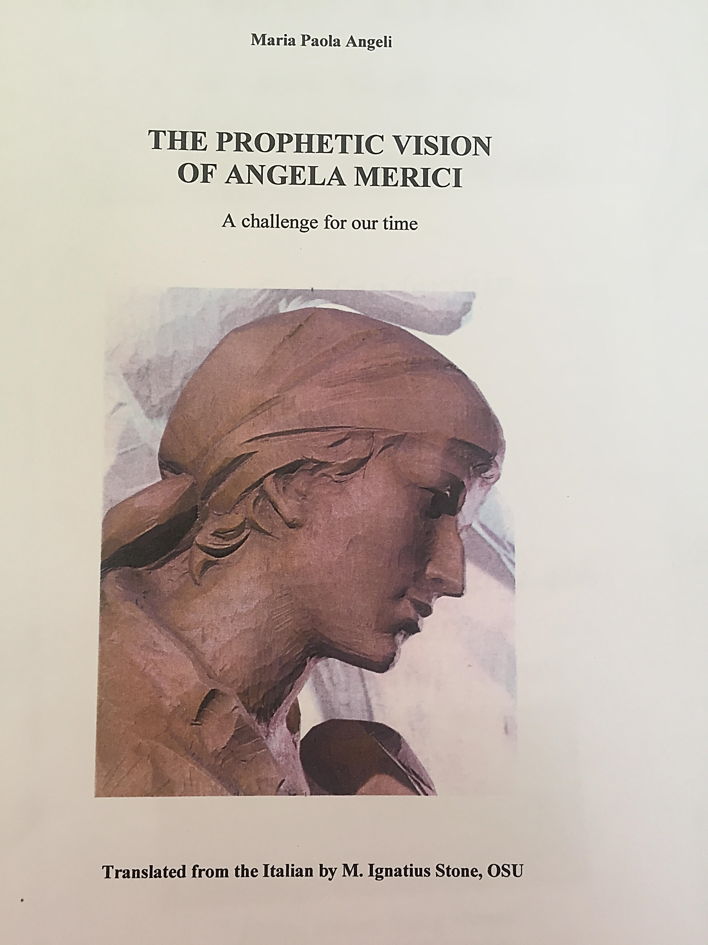
All the quotations in this presentation are taken from this book

Slide 2
Faith filled & hopeful 1
She joined the Franciscan Third Order, so that she could more easily participate in Mass, go to confession and receive Holy Communion.
Entitled to wear the recognised tunic, lead an austere life with frequent fasting, make charitable visits, help with the sick and the poor
No specific apostolate was allocated to her, and this enabled her to be ready for whatever plan God had in mind for her. P 8

Slide 3
Faith filled & hopeful 2
She was called Sur Anzola- active and contemplative p p8
Her dead sister in a vision: future mission as the foundress of a company of virgins – which she founded “in her own time, falling in with God’s command” p9
Impact of both Catherine of Alexandria and particularly Ursula- her joy and enthusiasm p12

Slide 4
Faith filled & hopeful 3
I have this firm and unquestioning faith and hope in infinite divine goodness, that not only shall we easily overcome all dangers and adversities but also, to our great joy and jubilation, we shall defeat them. We shall even spend this very short life of ours in consolation, and our every sorrow and sadness will be turned into joy and gladness, and we shall find the thorny and stony paths blossoming for us, and covered with paving of finest gold” p 19 Rule Prologue 23-27

Slide 5
Faith filled & hopeful 4
“For I tell you, living all together thus united in heart. You will be like a mighty fortress, or a tower impregnable” 9th Counsel, 15-16
The seven traditional gifts of the Holy Spirit p32/33: scripture knowledge, counsel, knowledge, piety, intelligence, fortitude, fear of God

Slide 6
Faith filled & hopeful 5
“Pray to him, humble yourselves under his great power, because, without doubt, as she has given you this charge, so he will give you the strength to be able to carry it out, provided you do not fail for your part. Act move, believe, strive, hope, cry put to him with all your heart, for without doubt you will see marvellous things.” Prologue, Counsel 16-18. p37
“For in these perilous and pestilential times, you will find no other recourse than to take refuge at the feet of Jesus Christ, because if he directs and teaches you, you will be well taught.” 7th Counsel 27-28 p37
The Merician charism: “to make present in the Church this Christ-Spouse mystery and to give witness to this in the world by one’s words and deeds” p 43

