Slide 1
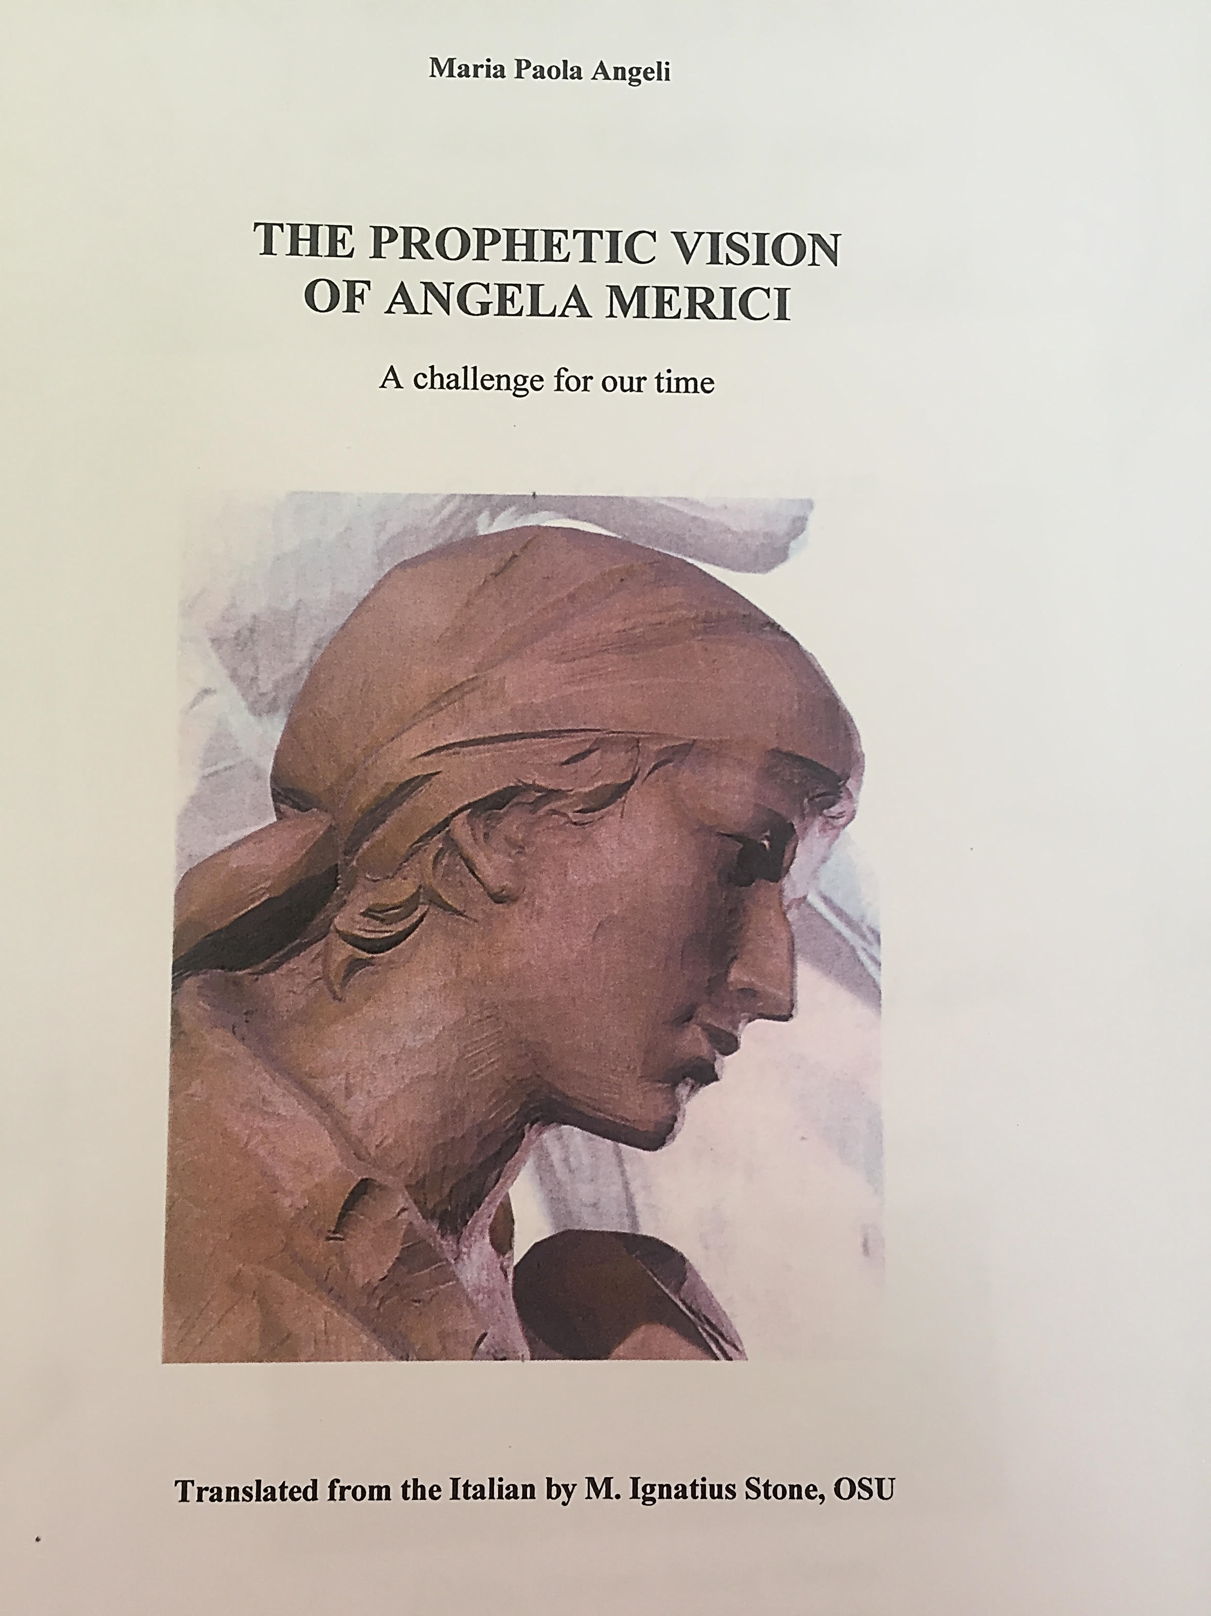
All the quotations in this presentation are taken from this book

Slide 2
Discerning & joyful 1
Angela the pilgrim, inspired by Ursula-joy and cheerfulness would characterise Merician spirituality 13
“God himself both inspired and urged our Mother Foundress to set up and establish , in his name, this holy rule of life. This rule of life was missing from holy Church and now the Church looks on it as one of the most beautiful gifts that God has ever bequeathed to the world.”
P 20 Cozzano
“For understand that now I am more alive than I was when I lived on earth.” Counsel 23-25
And I shall always be in your midst, helping your prayers” Counsel 20 p 40
“Keep to the ancient way…..and live a new life. 7th Counsel. 22 p V

Slide 3
Discerning & joyful 2
Angela interpreted the signs of her times, and by the grace of divine inspiration , she initiated a new way of life for women in the Church and in society – an alternative to the two traditional destinies “aut maritus aut murus” – marriage or the walls (of a convent or monastery) (Intro, p 1)
Love is the golden thread of Angela Merici’s prophecy, nurtured from listening to her the Word within her, brought to fruition through her life experience until she was able to carry out her ministry, even though a woman, with the recognised weight of authority. (Intro , p 1)

