Slide 1
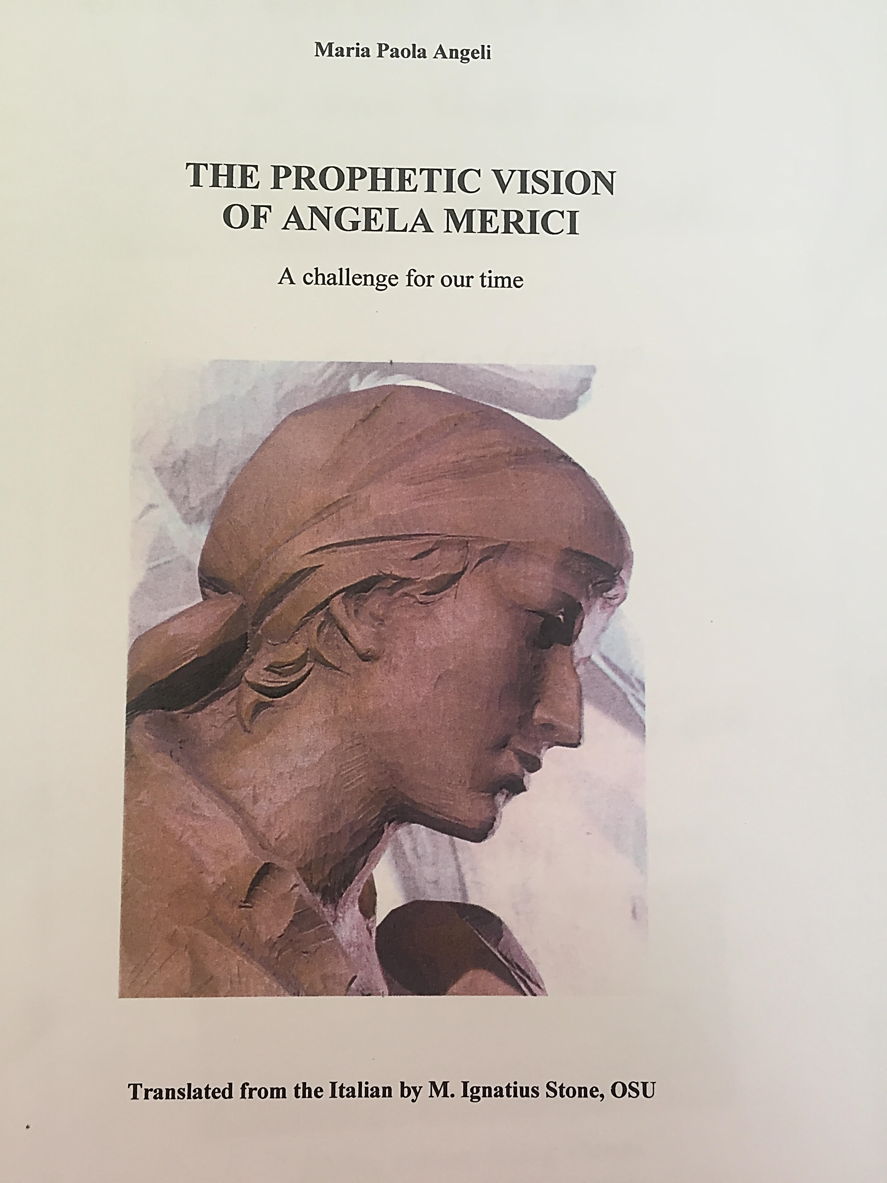
All the quotations in this presentation are taken from this book

Slide 2
Courageous & resilient 1
Angela always showed remarkable courage and resilience: she declined to stay in Venice in 1524 when invited by the city’s officials (10), to stay in Rome when invited by Pope Clement V11 in 1525, to stay in Varallo in 1529 – and at all times, she did so as she was convinced that God was calling her to do something completely different from becoming involved in immediate social and charitable works (11)
“And if, according to times and circumstances, the need arises to make new rules or do something differently, do it prudently and with good advice….For in this way, without doubt, Jesus Christ will be in your midst and as a true and good master, he will enlighten and teach you what you have to do” 21/22
Even though she lived the life of the ascetic, fasting and doing penance herself, she was anxious to set limits to any indiscreet corporal punishment her daughters might inflict upon themselves – which was a courageous stance as self infliction of punishment had, at that time, attraction for women in particular. 31

Slide 3
Courageous & resilient 2
In a world of “aut maritus aut murus” – marriage or the walls (of a convent or monastery), Angela’s proposal of her company was aimed at legitimising feminine celibacy and giving full rights and dignity to a state of life involved in following Christ. She gave it a structure that greatly surprised her contemporaries, by putting its direction completely in the hands of women. P. 7
“And so let each one strip herself of everything and to place all wealth, and love, and delight, not in goods, not in food and gluttony, not in relatives and friends, not in herself and in her resources and knowledge, but in God alone and in his gentle and ineffable Providence alone.” (p 34; Ch X, Rule 8-13)
Her vision for women was unorthodox – revolutionary in fact. She defied both the conventions of society and the conventions of the church. However, in a relatively short space of time, certain features became intrinsic Ursuline pedagogy: a spiritual and family atmosphere, trust and vigilance, strong and sensitive maternal affection, marked by optimism and prudence , understanding and firmness and based on personal and individual formation.

Slide 4
Courageous & resilient 3
Every attention should be given to the growth of the individual in a loving and respectful way 35
The 7 gifts of the Holy Spirit were very important to Angela and were hugely influential in how she conducted her life, providing as they did the foundations of both her courage and resilience : knowledge of the scriptures, counsel, knowledge, piety, intelligence, fortitude & fear of God (as described on 32/33) – these could be linked with the 7 stars of Serviam under the Serviam virtue.
“I have this firm and unquestioning faith and hope in infinite divine goodness, that not only shall we easily overcome all dangers and adversities, but also, to our great joy and jubilation, we shall defeat them.” (P 18)

