Slide 1



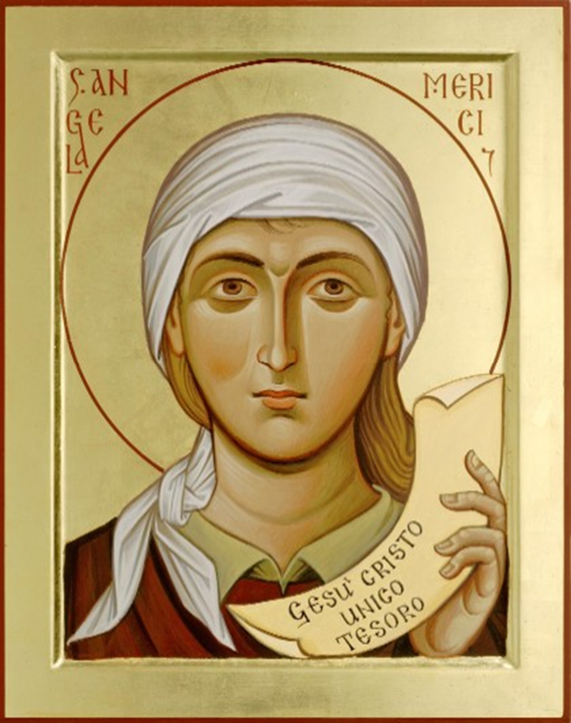




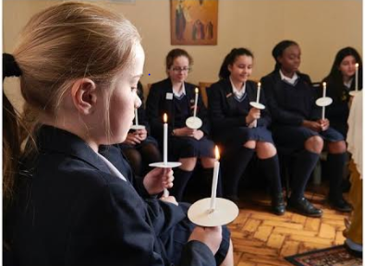






∼ . ∼ . ∼ Listening and Attentive ∼ . ∼ . ∼
Angela urges us to ‘be attentive, with great and eager hearts’. Her use of the words ‘great and eager’ implies a generosity and desire to respond to whatever is being asked of us, a willingness to strive, search and to persevere. She knows, however, we need guidance: ‘obey the counsels and inspirations which the Holy Spirit unceasingly sends into our hearts’.
‘Open my eyes, Lord. Help me to see.
Open my ears, Lord. Help me to hear your voice.
Open my ears, Lord. Help me to hear.
Open my heart, Lord. Help me to Love you.
Open my heart, Lord. Help me to Love”
Jesse Manibusan
“Speak, Lord, your servant is listening”
1 Sam 10
“LISTEN,
anyone who
has ears”
Mt.13.9
St Angela Merici
In guiding others Angela urges that the uniqueness of the student be taken into account and their: “condition and character, and their every situation
and state” .
Listening requires STILLNESS
and
SILENCE
Questions for Reflection
Does the school provide the space, the time and the guidance for students in the use of personal reflection?
Are students encouraged to gain self-knowledge by examining their reactions to daily experiences’?
What efforts are made to know and understand the uniqueness of each student in order to provide appropriate guidance?
Guide me Lord Jesus to make the right choice. Give me great wisdom, clear direction and the faith to take this leap, safe in your care and love. Amen
“Take care How you LISTEN”
Luke 8.18
“Stay Awake”
Mt. 25.13
Ursuline Schools help their students to discern their future by LISTENING to their experiences and being ATTENTIVE to the significance of the choices they make
“I know the plans that I have for you” says the Lord.
“Plans for your welfare, and not for calamity
to give you hope and a future” Jeremiah 20:11
The Ursuline Student Profile in the Merician Tradition ∼ . ∼ .
This Photo by Unknown Author is licensed under CC BY-NC-ND

