Slide 1
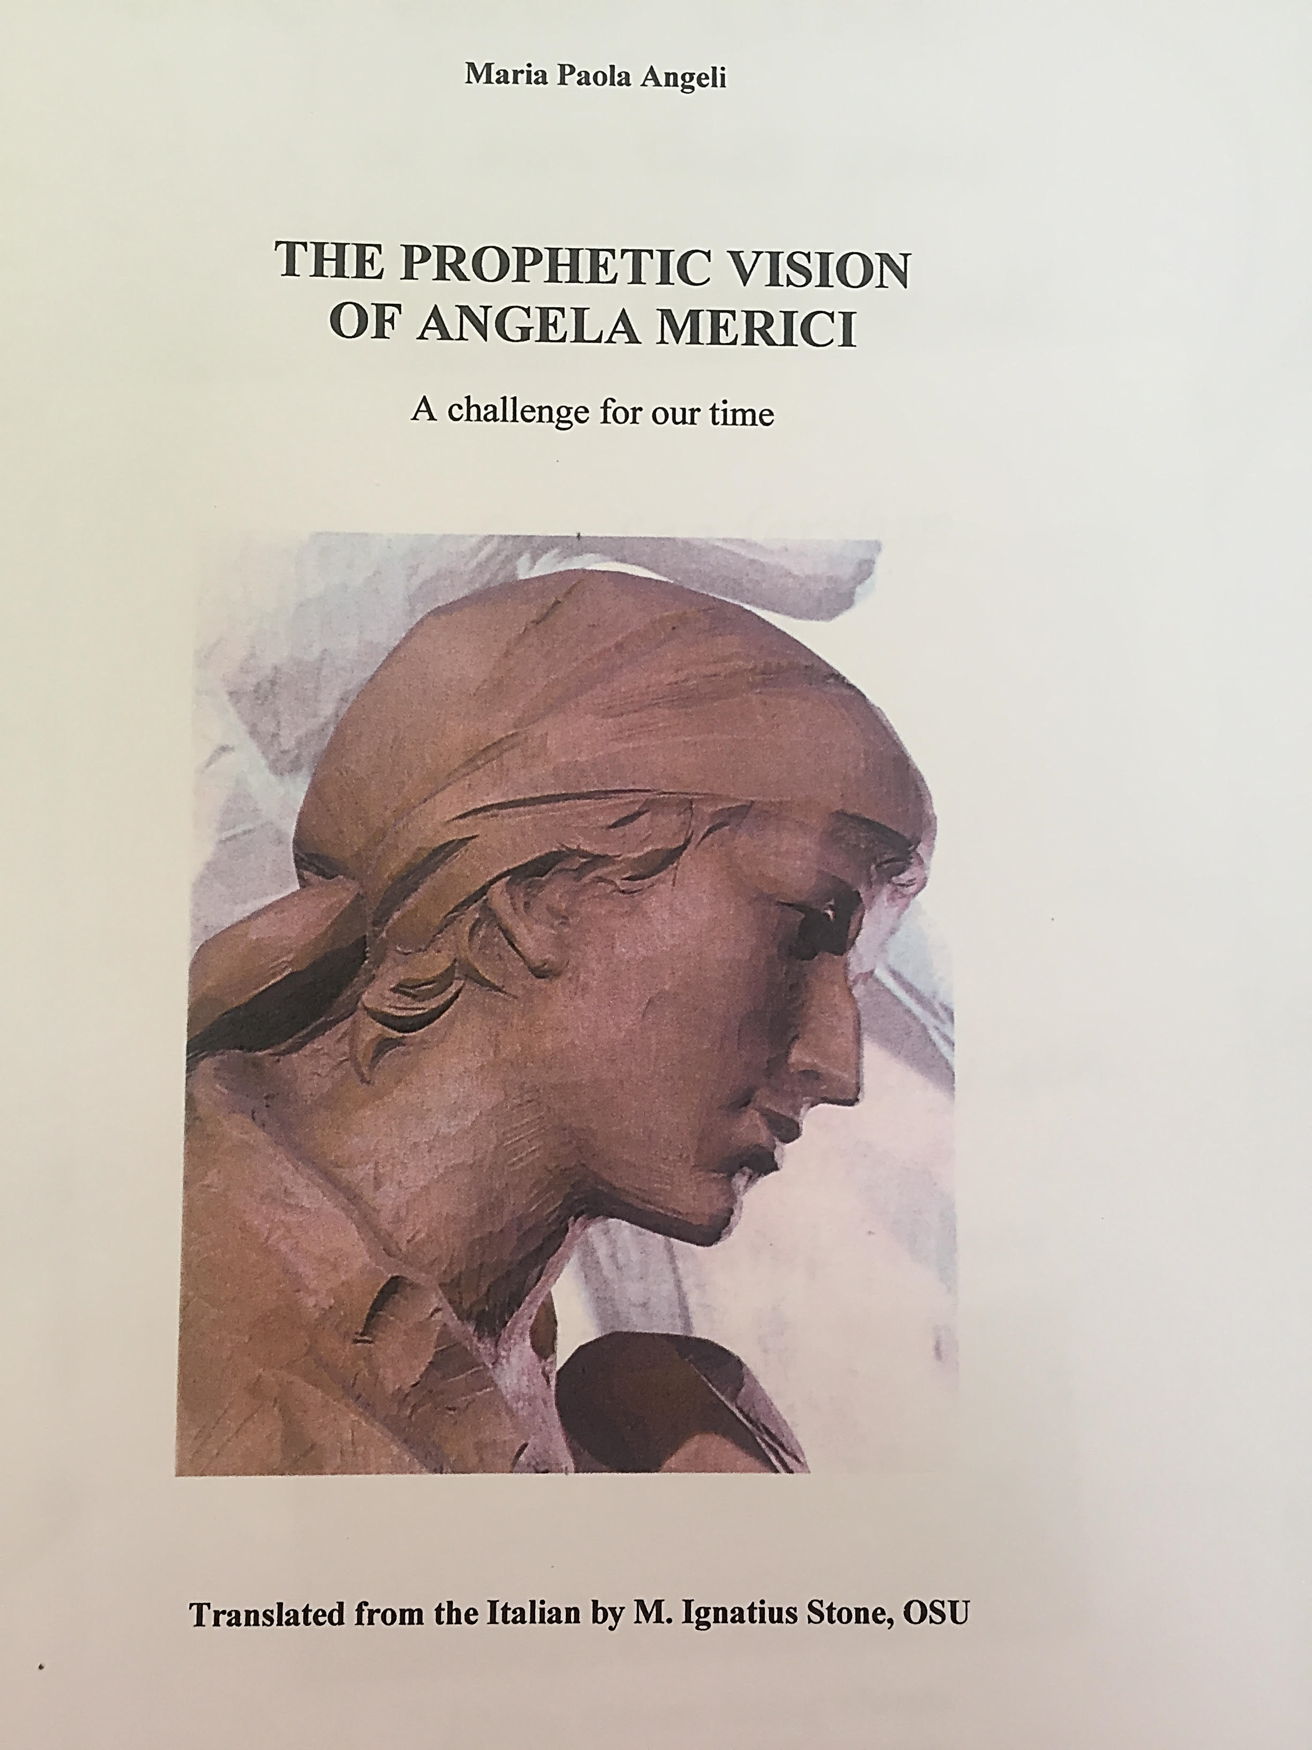
All the quotations in this presentation are taken from this book

Slide 2
Listening and attentive 1
The Spirit inspired the understanding that Angela had of the scriptures
She exercised “Motherhood of the word”, her gift of being able to listen to and welcome God’s word in the Scriptures p 10
Between 1520-1530- long pilgrimage to the roots her faith and the Church
Almost entirely blind, she saw the holy places “with interior eyesight”
The very structure of the message: the Rule for the members of the Company, the Counsels for the colonelle (local superiors) and Testament or the Legacies for the noble lady-governors or matrons p 10

Slide 3
Listening and attentive 2
Angela sensed the heartache and precarious life led by some many women of her day; wanting to consecrate themselves to God but forced to enter inside an enclosed monastery or household.
Finally after long deliberation, on November 25th, the feast of Catherine of Alexandria – she established the “Company of St Ursula” p 11:
Spiritual discernment – open to the unexpected and what is new “and where the daughters are, there also will be the mothers. Be consoled, do not doubt” p 25

Slide 4
Listening and attentive 3
Remain obedient to the principal mothers whom I leave in my place, since this is just…..and if it should happen that you have some just reason to contradict or reproach them, do it with discretion and respect, with discernment and maturity of judgement 3rd counsel 1, 6, 15 p 41
Angela was very “attentive to the role of women.” p16
Angela heard the cry of these women and intuitively guessed that the divine inspiration granted to her on that summer afternoon in Brudazzo had to take shape.

