Slide 1
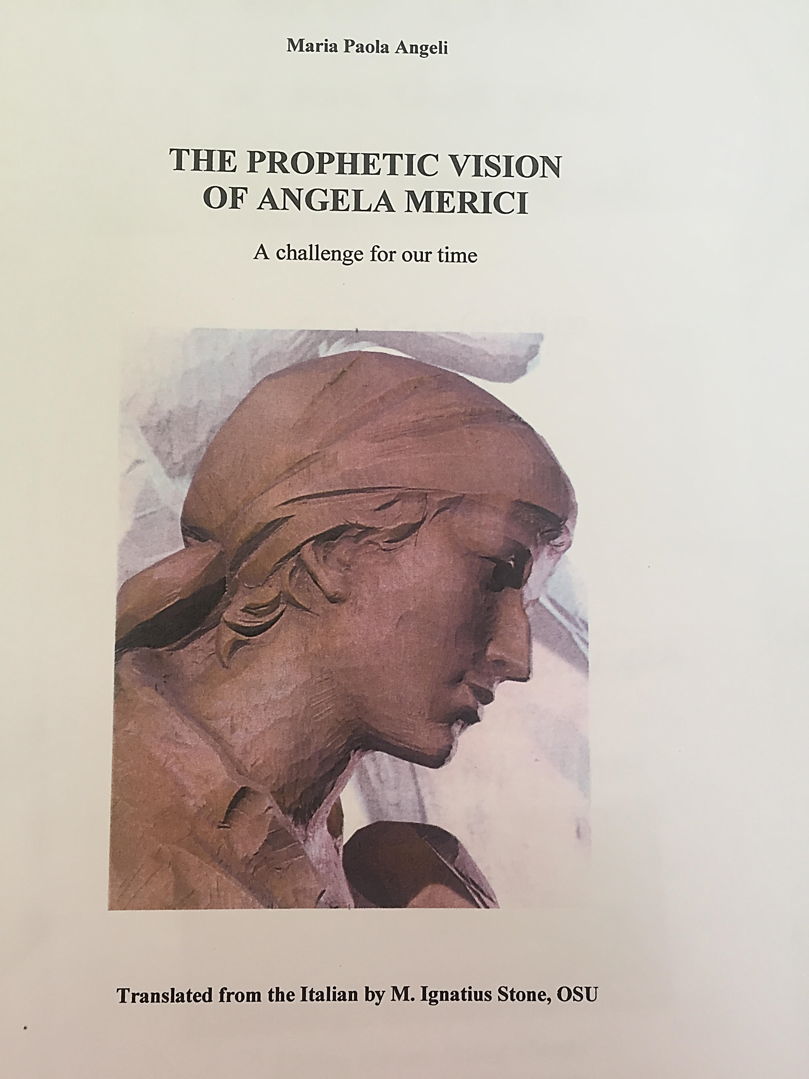
All the quotations in this presentation are taken from this book

Slide 2
Leading for justice
Her proposal was aimed at legitimising feminine celibacy and at giving full rights and dignity to a state of life involved in following Christ, by living the three evangelical counsels in the world
Company of St Ursula as a corporative body fully visible to all eyes
Completely in the hands of women and by involving a number of upper class women as a guarantee of the authenticity of her initiative p 7
A group of women from different social classes who wanted to devote themselves to God, a vocation they would carry out by living at home, carrying on with their daily tasks, while following a path of holiness in the company of others - united in one will 11
Company did not fit into any recognised symbolical or political pattern
A new form of life that symbolised a road to freedom p 20, revolutionary
Daughters- sisters –mothers – after the Trinity p 28.

Slide 3
Leading for justice 2
Angela named herself as their Madre, by calling them daughters, because they had been born into their new life in the name of the Trinity, making themselves open to the Spirit. She envisaged a communion between women within the framework of shared responsibility, dialogue, reciprocal love, freedom from any form of dominion, and correct exercise of authority.
“Let it also be recalled that each one be diligent in prayer, mental as well as vocal…..we advise frequent vocal prayer through which the senses are awakened and one disposes oneself for vocal prayer” p 31
Angela dedicated her legacies to the widows- phenomenally forward thinking- tapping into the wisdom and experience of the older woman- the sage, the wise elder 35
“and always let your principal recourse be to gather at the feet of Jesus Christ, and there, all of you, with all your daughters, to offer fervent prayers Legacies 3-4, p 35
And she included men: the presence of men, as custodians of peace and unity, acting as fathers p 35

Slide 4
Leading for justice 3
I remind you to strive, with the help of God, to take hold of and plant within you this right conviction and humble sentiment: do not consider yourselves worthy to be superiors or leaders. Rather, regard yourselves as ministers and servants, reflecting that you have more need to serve them than they have to be served by you or governed. Learn from our Lord whom while he was in this world, was a servant, obeying the Eternal Father even unto death. 1st counsel 2-3, 6, 8-9 p 38
Protect and defend the daughters from “wolves and robbers and from worldly persons or false religious with their deceits, and heretics P45
“When you hear that some preachers or other persons has a reputation for heresy or preaches new things outside the common practice of the church and contrary to what you have received from us……leave them alone. Consider each one as good but be prudent for you own good” 7th counsel, 12-14 & 19-20 p 45
“And live a new life.” 7th Counsel 22 p 44

