Slide 1
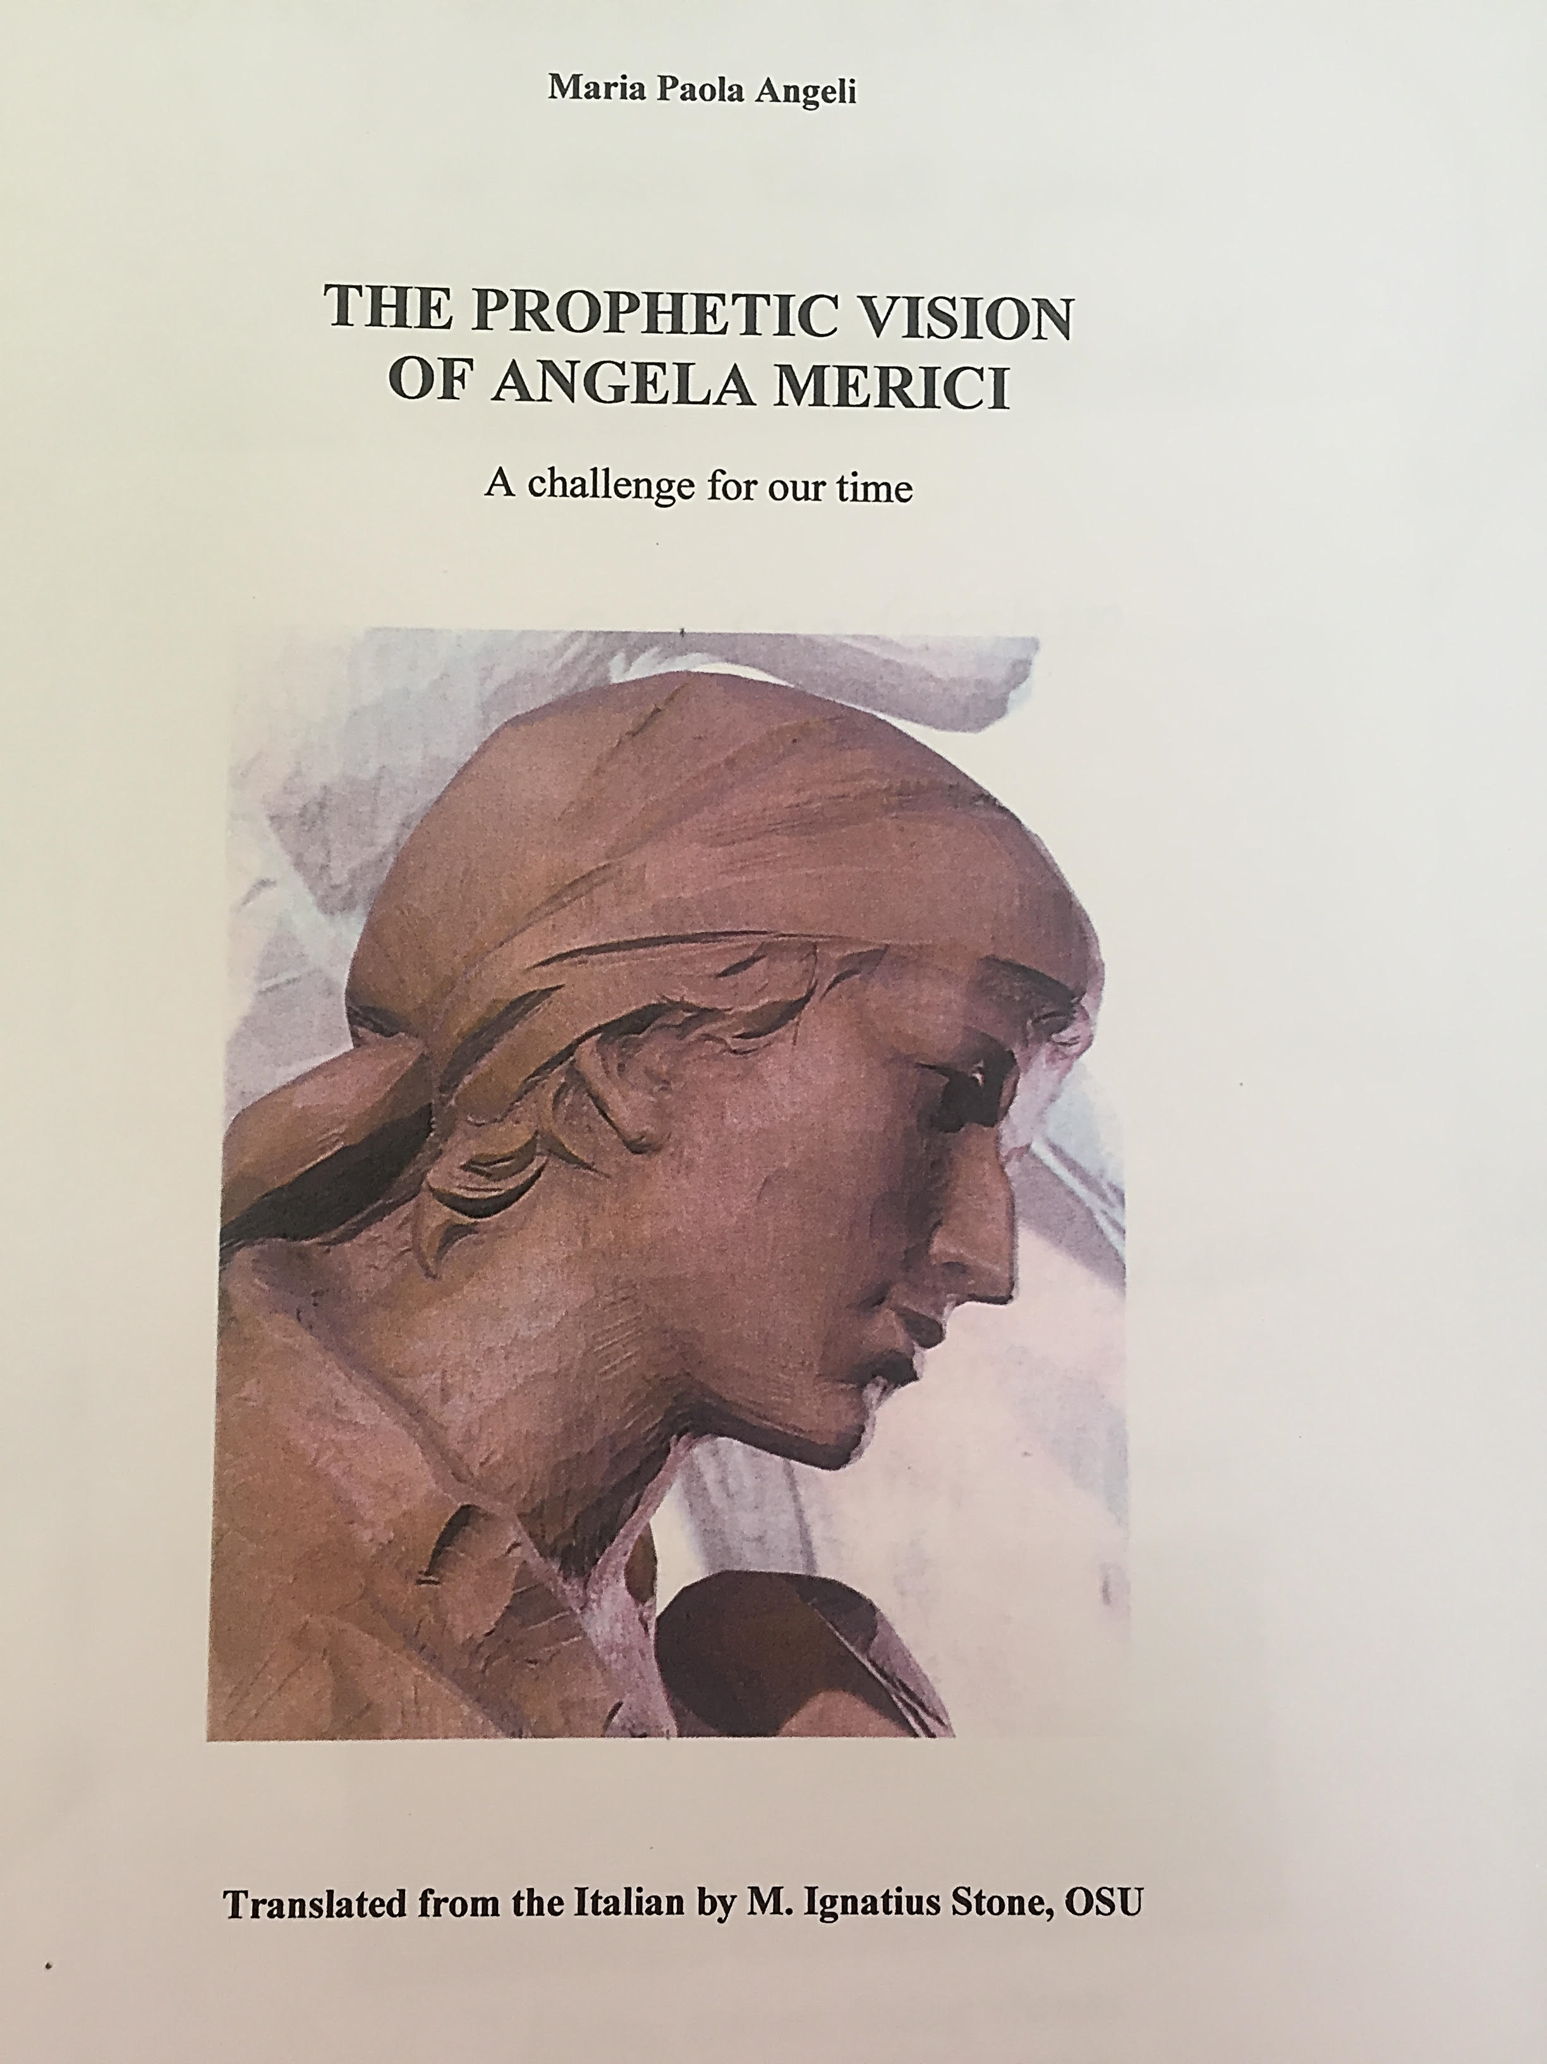
All the quotations in this presentation are taken from this book

Slide 2
Acting with truth & integrity 1
Angela’s ministry was hermeneutical – from the Greek to “interpret” – one of her greatest gifts was to “keep to the ancient way… and live a new life” and this she did, always acting with both truth and integrity.
“Her gift of counselling and her ability to act as a reconciler are singled out- she is presented as a woman of peace “donna disarmante” (the disarming woman.(Preface, p V)
“Know that you have to defend and protect your lambs from wolves and robbers, that is from two kinds of pestilential people: worldly persons or false religious with their deceits, and heretics……Consider each one as good, but be prudent for your own good. For it is better to follow what is certain, without danger than what is uncertain with danger. Keep to the ancient way….and live a new life. As for other opinions that are arising now, and will arise, leave them aside as not concerning you. But pray and get others to pray, that God not abandon his Church, but reform it as he pleases.” (7th Counsel, 1, 19-24- p 4)

Slide 3
Acting with truth & integrity 2
Angela was very familiar with the debate between relative virtue of the contemplative and the active life which was so prevalent in religious circles. Angela promoted a new form a feminine of religious life - the “sante vive” (holy lives) (bt P 6)
“Her proposal was aimed at legitimising feminine celibacy and at giving full rights and dignity to a state of life involved in following Christ, by living the three evangelical counsels in the world……. She gave it a structure which surprised her contemporaries, by putting its direction completely in the hands of women and by involving a number of upper class women as a guarantee of the authenticity of her initiative. She offered women, free of marital bonds the right to become members of the Company….. Today, she and her Company are recognised as playing not only a leading role in introducing a new form of religious life, but also in the development of the condition of women between the 16th and 21st centuries.” P 7
Angela always acted with truth and integrity

Slide 4
Acting with truth & integrity 3
On the way to the Holy Land, somewhere near Crete “she became almost entirely blind, but saw the holy places “with interior eyesight”….. Prostrating herself on the ground at Calvary….. meditating on the mysteries of Christ left an indelible imprint on her.” P 10
Her innovative proposal for a “third way of life” (not married nor in the convent) as explained in her writings had a socio-political dimension which demanded acting with truth and integrity. (P 12)

Slide 5
Acting with truth & integrity 4
“Throughout the centuries, therefore, the vitality of the Counsels, although weakened , was promoted by the Order of St Ursula to enhance the renown of Angela Merici in the world.
In a short space of time, certain features became attached to Ursuline pedagogy: a spiritual and family atmosphere, rust & vigilance, strong and sensitive maternal affection, marked by optimism and prudence, understanding and firmness and based on personal and individual formation.” (bt p 22)

